Slide 1
There are 7 Feasts of Israel
Spring Feasts
1. PASSOVER
2. FEAST OF UNLEAVENED BREAD
3. FEAST OF FIRSTFRUITS
4. FEAST OF PENTECOST (WEEKS)
Fall Feasts
5. FEAST OF TRUMPETS
6. DAY OF ATONEMENT
7. FEAST OF TABERNACLES

Slide 2
Time Line of Feasts
Passover
Unleavened Bread
Sheaf of First Fruits
Nisan
Pentecost
Sivan
Interval
Tammuz
Av
Elul
Trumpets
Day of Atonement
Tabernacles
Tishrei
1st Month
3rd Month
4th,5th,6th Months
7th Month

Slide 3
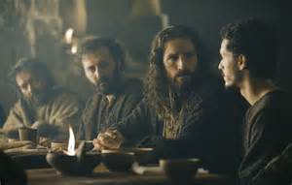
Time Line of Feasts
3 feasts Happen simultaneously
Passover ---14th
Unleavened Bread---15th- 21st
Sheaf of First Fruits---17th
1st Month of Nisan

Slide 4
Time Line of Feasts
The names of Passover and Unleavened bread are used interchangeably
Luk 22:1 Now the feast of unleavened bread drew nigh, which is called the Passover.
Mar 14:12 And the first day of unleavened bread, when they killed the passover, his disciples said unto him, Where wilt thou that we go and prepare that thou mayest eat the passover?
Luk 22:7 Then came the day of unleavened bread, when the passover must be killed.

Slide 5
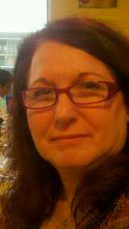
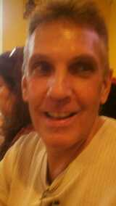
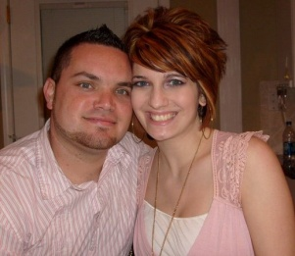
The Feast of Passover -Review
Psa 89:15 Blessed (happy, fortunate, to be envied) are the people who know the joyful sound [who understand and appreciate the spiritual blessings symbolized by the feasts]; they walk, O Lord, in the light and favor of Your countenance!
1Co 5:7 …. For even Christ our Passover is sacrificed for us:
“Gods people are safe under the Blood of the Lamb”
What does Passover mean? “Pesach” Translated Passover means a Passing over.

Slide 6
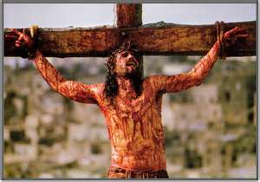
Passover took place on the 14 th Day of Nissan
Luk 23:44 And it was about the sixth hour, and there was a darkness over all the earth until the ninth hour.
Luk 23:45 And the sun was darkened, and the veil of the temple was rent in the midst.
Luk 23:46 And when Jesus had cried with a loud voice, he said, Father, into thy hands I commend my spirit: and having said thus, he gave up the ghost.
“Between the Evenings” or 3:00 PM
Joh 18:39 But ye have a custom, that I should release unto you one at the passover: will ye therefore that I release unto you the King of the Jews?
Nisan 14th Day Passover

Slide 7
Passover took place on the 14 th Day of Nissan
Exo 12:6 And ye shall keep it up until the fourteenth day of the same month: and the whole assembly of the congregation of Israel shall kill it in the evening.
Jesus died on Passover
“Between the Evenings” or 3:00 PM
Nisan 14th Day Passover
Lev 23:5 In the fourteenth day of the first month at even is the LORD's passover.

Slide 8
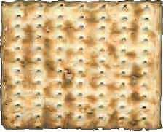
FEAST OF UNLEAVENED BREAD TIMELINE
Lev 23:6 And on the fifteenth day of the same month is the feast of unleavened bread unto the LORD: seven days ye must eat unleavened bread.
Lev 23:7 In the first day ye shall have a holy convocation: (Dress Rehearsal) ye shall do no servile work therein.
Lev 23:8 But ye shall offer an offering made by fire unto the LORD seven days: in the seventh day is a holy convocation: (Dress Rehearsal) ye shall do no servile work therein.

Slide 9
FEAST OF UNLEAVENED BREAD TIMELINE
Exo 12:15 Seven days shall ye eat unleavened bread; even the first day ye shall put away leaven out of your houses: for whosoever eateth leavened bread from the first day until the seventh day, that soul shall be cut off from Israel.
Exo 12:16 And in the first day there shall be a holy convocation, (dress Rehearsal) and in the seventh day there shall be a holy convocation (dress Rehearsal) to you; no manner of work shall be done in them, save that which every man must eat, that only may be done of you.
Exo 12:17 And ye shall observe the feast of unleavened bread; for in this selfsame day have I brought your armies out of the land of Egypt: therefore shall ye observe this day in your generations by an ordinance forever.
Exo 12:18 In the first month, on the fourteenth day of the month at even, (6:00P.M.) ye shall eat unleavened bread, until the one and twentieth day of the month at even.
Exo 12:19 Seven days shall there be no leaven found in your houses: for whosoever eateth that which is leavened, even that soul shall be cut off from the congregation of Israel, whether he be a stranger, or born in the land.
Exo 12:20 Ye shall eat nothing leavened; in all your habitations shall ye eat unleavened bread.

Slide 10
FEAST OF UNLEAVENED BREAD TIMELINE
When does the Feast of Unleavened Bread Begin?
Lev 23:6 On the fifteenth day of that month the LORD's Feast of Unleavened Bread begins; for seven days you must eat bread made without yeast.
Exo 12:18 In the first month, on the fourteenth day of the month at even, ye shall eat unleavened bread, until the one and twentieth day of the month at even.
Does this Feast Begin on the 14th Day or the Fifteenth Day of Nisan?
The answer is Yes!

Slide 11
FEAST OF UNLEAVENED BREAD TIMELINE
Leaven or “Yeast” in the Bible is a type of sin. Leaven means “sour”
Even or 6:00 P.M.
7 Day Feast of Unleavened Bread
Nisan 14th Day Passover
Nisan 15th Day
Unleavened Bread
Nisan 21st nd Day
Unleavened Bread
Exo 12:18 In the first month, on the fourteenth day of the month at even, ye shall eat unleavened bread, until the one and twentieth day of the month at even.

Slide 12
FEAST OF UNLEAVENED BREAD TIMELINE
Leaven or “Yeast” in the Bible is a type of sin. Leaven means “sour”
6:00 P.M. Begins a New Day
6:00 P.M. New Day
7 Day Feast of Unleavened Bread
Nisan 14th Day Passover
Nisan 15th Day
Unleavened Bread
Nisan 21st nd Day
Unleavened Bread
A Hebrew day was from “even to even”. We would say sunset to sunset.
6:00P.M. – 6:00P.M.

Slide 13
FEAST OF UNLEAVENED BREAD
Leaven or “Yeast” in the Bible is a type of sin. Leaven means “sour”
Matza
Even or 6:00 P.M. It’s a New Day!
7 Day Feast of Unleavened Bread
Nisan 14th Day Passover
Nisan 15th Day
Unleavened Bread
Nisan 21st Day
Unleavened Bread
Lev 23:6 On the fifteenth day of that month the LORD's Feast of Unleavened Bread begins; for seven days you must eat bread made without yeast.

Slide 14
A Hebrew Day is from 6:00P.M. to 6:00 P.M.
24 Hrs
24 Hrs
24 Hrs
24 Hrs
24 Hrs
24 Hrs
24 Hrs
6:00 P.M. 6:00 P.M. 6:00 P.M. 6:00 P.M. 6:00P.M. 6:00P.M. 6:00P.M.
Mon
Tue
wed
Thur
Fri
Sat
Sun
Exo 12:15 Seven days shall ye eat unleavened bread; even the first day ye shall put away leaven out of your houses: for whosoever eateth leavened bread from the first day until the seventh day, that soul shall be cut off from Israel.
Exo 12:17 And ye shall observe the feast of unleavened bread; for in this selfsame day have I brought your armies out of the land of Egypt: therefore shall ye observe this day in your generations by an ordinance forever.
Exo 12:18 In the first month, on the fourteenth day of the month at even, (beginning the Fifteenth Day) ye shall eat unleavened bread, until the one and twentieth day of the month at even.

Slide 15
This would mean that Jesus ate the Passover on Nissan 14th
We would say he ate it on Tuesday Night.
Jesus instituted the Lord’s Supper to replace the Passover forever.
1Co 5:7…. For Christ, our Passover lamb, has been sacrificed.

Slide 16
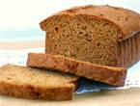
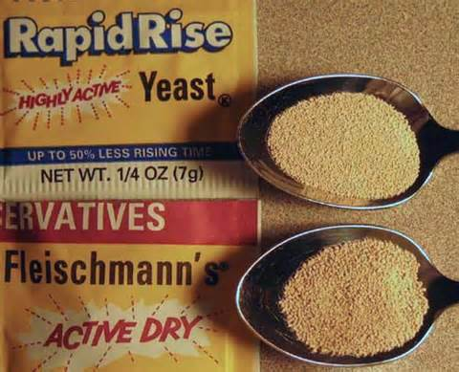
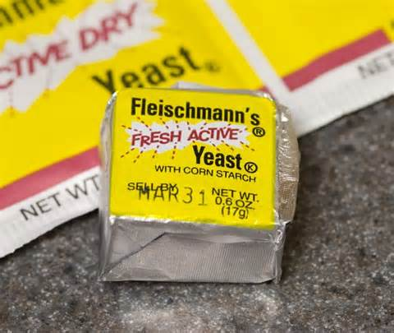
FEAST OF UNLEAVENED BREAD
Leaven Naturally
What is leaven? Leaven or yeast is a little bit of sour dough, and when placed in a batch of dough has the action of fermentation. Leaven puffs up. It works silently, secretly and gradually, until the whole is leavened. All the dough is affected by its mysterious operation and fermentation. It causes the dough to rise. Its influence permeates the whole until all is leavened, until all becomes like itself.
The Hebrew word used for leavening in Scripture is Chametz. It literally means 'sour'. It is that essence by which things decay. It is a fermentation process - a process of death.

Slide 17
FEAST OF UNLEAVENED BREAD
Leaven Spiritually
The word leaven occurs ninety-eight times in the Bible— seventy-five times in the Old Testament and about twenty-three times in the New Testament—and it is always used in a bad sense except once in Matthew 13:33. In every other instance that leaven is used in scripture it is used to symbolize evil, either in doctrine or practice. Leaven typifies sin, human weakness, infirmities, false doctrine, and corrupt practices.
The Hebrew word used for leavening in Scripture is Chametz. It literally means 'sour'. It is that essence by which things decay. It is a fermentation process - a process of death.

Slide 18
3 Loaves of Bread
Leaven is always used in a negative sense except here
Mat 13:33 Another parable spake he unto them; The kingdom of heaven is like unto leaven, which a woman took, and hid in three measures of meal, till the whole was leavened.
Gentiles
Jews
Church
The Kingdom of Heaven is made up of three people groups. The whole will be leavened or the Gospel brought to all the earth.
1Co 10:32 Give none offense, neither to the Jews, nor to the Gentiles, nor to the church of God:

Slide 19
FEAST OF UNLEAVENED BREAD
The Unleavened Matzo a Symbol of Jesus
The unleavened Matzo looks bruised and striped
Isa 53:5 But he was wounded for our transgressions, he was bruised for our iniquities: the chastisement of our peace was upon him; and with his stripes we are healed.
The unleavened Matzo is pierced
Psa 22:16 For dogs have compassed me: the assembly of the wicked have enclosed me: they pierced my hands and my feet.

Slide 20
FEAST OF UNLEAVENED BREAD
The Unleavened Matzo a Symbol of Jesus
The Matzo is an adequate symbol of the body of the Messiah for five reasons.
It is made without leaven which is a symbol of sin. Likewise, Yeshua was sinless.
It is made without salt. A rich man could afford to flavor his matzo with salt but a poor man could not. In the same manner, Yeshua was a poor carpenter.
The matzo is striped from hot, swift baking. Likewise, His body was striped by means of the Roman whip.
The matzo is pierced to prevent rising. Similarly, His body was pierced by the Roman nails in His hands and feet and the Roman spear thrust in his side.
Finally, during the Seder the matzo is broken. This action dramatizes His death on the cross when His soul was torn away from his body.

Slide 21
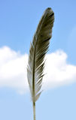
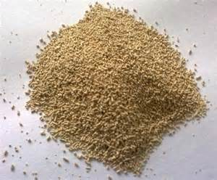
FEAST OF UNLEAVENED BREAD
Jewish Tradition
Every speck of leaven is removed from the Jewish home before Passover. God didn‘t want the symbol of sin to be present in the Jewish home for this festival. The morning before the Passover, the House is cleaned of all leaven. The Father with the children begins a diligent search of the house for any left over leaven using a feather and wooden spoon. The mother usually sprinkles a little leaven in the kitchen for the father and children to find. The leaven is swept onto the spoon by the feather, wrapped in a cloth, taken outside and burned. The father then declares his house clean and prepared for Passover.
Holy Spirit
Sin
The Cross

Slide 22
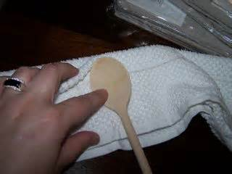
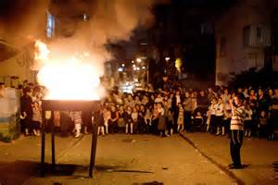
FEAST OF UNLEAVENED BREAD
Jewish Tradition
Heb 13:11 For when the blood of animals is brought into the sanctuary by the high priest as a sacrifice for sin, the victims' bodies are burned outside the limits of the camp. [Lev. 16:27.]
Heb 13:12 Therefore Jesus also suffered and died outside the [city's] gate in order that He might purify and consecrate the people through [the shedding of] His own blood and set them apart as holy [for God].
Heb 13:13 Let us then go forth [from all that would prevent us] to Him outside the camp [at Calvary], bearing the contempt and abuse and shame with Him. [Lev. 16:27.]

Slide 23
FEAST OF UNLEAVENED BREAD
The significance of Unleavened Bread
1.) Unleavened Bread was used in the consecration of the priests.
Lev 8:2 Take Aaron and his sons with him, and the garments, and the anointing oil, and a bullock for the sin offering, and two rams, and a basket of unleavened bread;
2.) Unleavened Bread was used in the vow of separation of the Nazarite unto the Lord. Num 6:2 Speak unto the children of Israel, and say unto them, When either man or woman shall make a special vow, the vow of a Nazirite, to separate himself unto Jehovah,
3.) Unleavened Bread was used for food for the Priests. Lev 6:16 And that which is left thereof shall Aaron and his sons eat: it shall be eaten without leaven in a holy place; in the court of the tent of meeting they shall eat it.
4.) Unleavened Bread was used in all the Feasts except Pentecost. Lev 23:6 And on the fifteenth day of the same month is the feast of unleavened bread unto Jehovah: seven days ye shall eat unleavened bread.
4.) Unleavened Bread was used when the Angel of the Lord appeared to Gideon. Jdg 6:20 And the angel of God said unto him, Take the flesh and the unleavened cakes, and lay them upon this rock, and pour out the broth. And he did so.
The Symbolic truths in Unleavened are “Consecration and Separation “ unto the Lord.

Slide 24
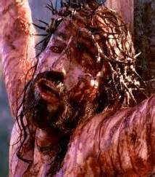
FEAST OF UNLEAVENED BREAD
The seven day Feast speaks of complete Separation of the believer from all things that are leavened (sinful) to feed upon Christ who is the believers pure Bread.
Exo 12:15 Seven days shall ye eat unleavened bread; even the first day ye shall put away leaven out of your houses: for whosoever eateth leavened bread from the first day until the seventh day, that soul shall be cut off from Israel.
Rom 6:23 For the wages of sin is death; but the free gift of God is eternal life in Christ Jesus our Lord.
Dan 9:26 And after threescore and two weeks shall Messiah be cut off, but not for himself:
2Co 5:21 For he hath made him to be sin for us, who knew no sin; that we might be made the righteousness of God in him.

Slide 25
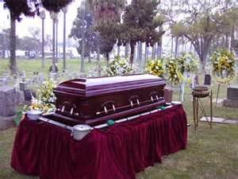
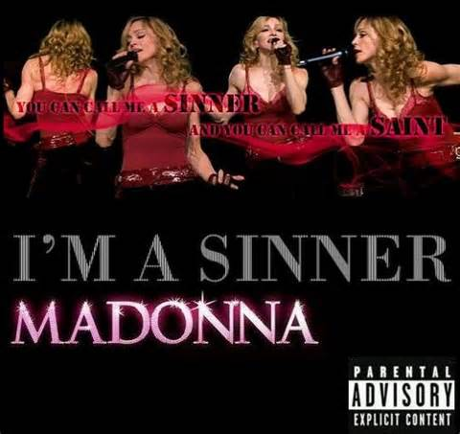
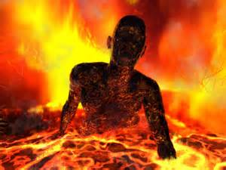
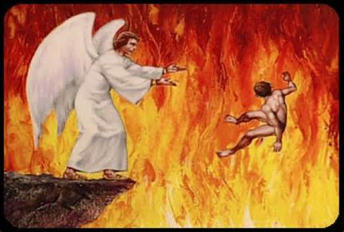
FEAST OF UNLEAVENED BREAD
The Picture of being cut off is that sin brings Death! Which is separation.” whosoever eateth leavened bread from the first day until the seventh day, that soul shall be cut off from Israel”
There are 4 types of Death
Physical Death
Spiritual Death
Eternal Death
The Second Death

Slide 26
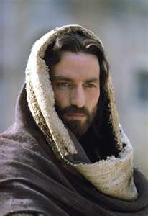
FEAST OF UNLEAVENED BREAD
The seven day Feast speaks of complete Separation of the believer from all things that are leavened (sinful) to feed upon Christ who is the believers pure Bread.
1Co 5:8 Therefore, let us keep the feast, not with old leaven, nor with leaven of vice and malice and wickedness, but with the unleavened [bread] of purity (nobility, honor) and sincerity and [unadulterated] truth. [Exod. 12:19; 13:7; Deut. 16:3.]
Joh 1:1 IN THE beginning [before all time] was the Word (Christ), and the Word was with God, and the Word was God Himself. [Isa. 9:6.]
Psa 19:7 The law of the LORD is perfect, converting the soul: the testimony of the LORD is sure, making wise the simple.
Job 23:12 Neither have I gone back from the commandment of his lips; I have esteemed the words of his mouth more than my necessary food.

Slide 27
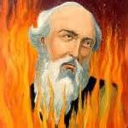
FEAST OF UNLEAVENED BREAD
The Bible calls Believers Unleavened
1Co 5:7 Purge out therefore the old leaven, that ye may be a new lump, as ye are unleavened.
1Co 5:8 Therefore let us keep the feast, not with old leaven, neither with the leaven of malice and wickedness; but with the unleavened bread of sincerity and truth.
Polycarp Jesus‘ unleavened Martyr
160 AD, of the martyrdom of Polycarp, the Bishop of the church in Smyrna
Then the fire was lit, and the flame blazed furiously. We who were privileged to witness it saw a great miracle, and this is why we have been preserved, to tell the story. The fire shaped itself into the form of an arch, like the sail of a ship when filled with the wind, and formed a circle around the body of the martyr. Inside it, he looked not like flesh that is burnt, but like bread that is baked, or gold and silver glowing in a furnace. And we smelt a sweet scent, like frankincense or some such precious spices.

Slide 28
FEAST OF UNLEAVENED BREAD
This Feast was to Last for 7 Days
7 Day Feast of Unleavened Bread
Nisan 15th Day
Unleavened Bread
Nisan 21st Day
Unleavened Bread
Lets take a Brief look at the meaning of the number 7
The number 7 Seven is God’s number of perfection. It is used over 700 times in the Bible, showing us that Gods book is perfect and complete.
A common phrase that is found in the Old Testament, "Thus saith the Lord of Hosts", is a phrase that reveals to us that God has indeed given us the very words that have come directly from His mouth. This phrase is found exactly 70 (7 x 10) times in the King James Bible.

Slide 29
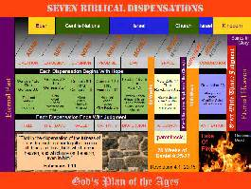
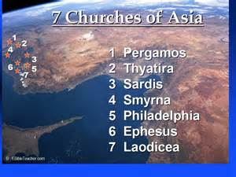
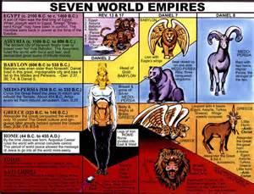
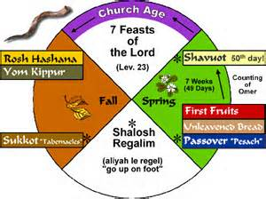
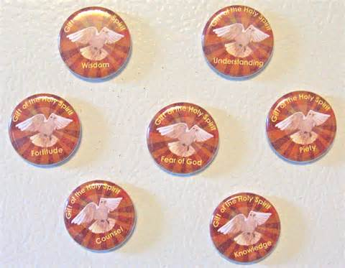
The number 7 is God's number throughout the Bible, and is associated with Divine completion and perfection. It becomes apparent to most who read the Scriptures that the number 7 is the most significant number in all of the Scriptures. Some examples of this are……
7 Dispensations
7 Churches
Wisdoms 7 pillars
7 Seals
7 Trumpets
7 Vials
7 world Empires
7 Fold Holy Spirit
7 Feasts

Slide 30
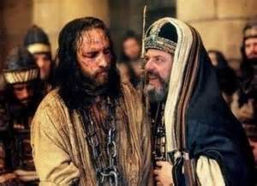
Another example of this is Jesus our Perfect Sacrifice Bled Seven Times
1st Garden of Gethsemane - Luke 22:44
And being in an agony he prayed more earnestly: and his sweat was as it were great drops of blood falling down to the ground.
1st
2nd
2nd Pulling of His Beard -Luke 22:63-64
And the men that held Jesus mocked him, and smote him. [64] And when they had blindfolded him, they struck him on the face, and asked him, saying, Prophesy, who is it that smote thee?
Isaiah 50:6 - I gave my back to the smiters, and my cheeks to them that plucked off the hair: I hid not my face from shame and spitting.

Slide 31
Jesus our Perfect Sacrifice Bled Seven Times
3rd Flogging - Mark 15:15 Wanting to satisfy the crowd, Pilate released Barabbas to them. He had Jesus flogged, and handed him over to be crucified.
3rd
4th
4th Crown of Thorns - John 19:2-3 The soldiers twisted together a crown of thorns and put it on his head. They clothed him in a purple robe and went up to him again and again, saying, "Hail, king of the Jews!" And they struck him in the face.

Slide 32
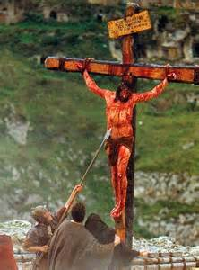
Jesus our Perfect Sacrifice Bled Seven Times
5th Nails in Hands 6th Nail in Feet
- Psalm 22:16
For dogs have compassed me: the assembly of the wicked have inclosed me: they pierced my hands and my feet.
5th & 6th
7th
7th Sword Piercing His Side - John 19:34
But one of the soldiers with a spear pierced his side, and forthwith came there out blood and water.

Slide 33
FEAST OF UNLEAVENED BREAD
There are Five types of Leaven mentioned in the New Testament
Leaven of the Pharisees
Leaven of the Sadducees
Leaven of Herod
Leaven of Galatia
Leaven of Corinth

Slide 34
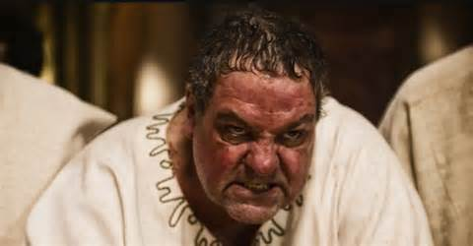
FEAST OF UNLEAVENED BREAD
There are Five types of Leaven mentioned in the New Testament
The Leaven we want to look at is the Leaven of the Herodians (King Herod Loved the World)
Mark 8:15
And he charged them, saying, Take heed, beware of the leaven of the Pharisees, and of the leaven of Herod.
King Herod was an Unscrupulous, crafty, immoral, cruel, lustful,decietful,cunning and murderous man.

Slide 35
The Leaven of Herod
Herod’s title, king of the Jews, was granted by Rome 37 B.C. he was 4 foot 4. He was never accepted by the Jewish people. He was not part of the Davidic family line, and he was only partly Jewish. Although Israel benefited from Herod’s lavish efforts to repair the Temple in Jerusalem, he won little admiration because he also rebuilt various pagan temples. Herod’s costly attempt to gain the loyalty of the people failed because it was superficial. His only loyalty was to himself.
because his royal title was not genuine, Herod was constantly worried about losing his position.
He also was horribly cruel and paranoid. He thought that his sons and his wife, Miriam, were plotting against him, so he had them all put to death. Then he began to miss Miriam, so he built a big monument to Miriam because he missed her after he had killed her. Cesar Augustus said "It's safer to be Herod's pig than to be his son,"
Now in time, he realized that as the result of his own cruelty and meanness, no one would weep when he died. And he couldn't stand the thought of no one weeping when he died, so he gave orders that when he died all of his 100 top officials were to be killed, executed,

Slide 36
The Leaven of Herod
LESSONS FROM HIS LIFE
• Great power brings neither peace nor security
• No one can prevent God’s plans from being carried out
• Superficial loyalty does not impress people or God
Because of his sin. Herod was eventually afflicted with a loathsome disease, accompanied by fever.
Josephus the Jewish historian describes it as…
An Intolerable itching over all the surface of his body, and continual pains in his colon, and dropsical tumors about his feet and an inflammation of the abdomen…and a putrefication…that produced worms…

Slide 37
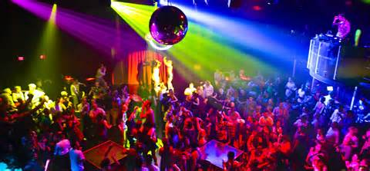
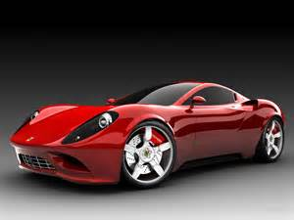
The Leaven of Herod
1 John 2:15-17 (AMP)
15 Do not love or cherish the world or the things that are in the world. If anyone loves the world, love for the Father is not in him.
16 For all that is in the world—the lust of the flesh [craving for sensual gratification] and the lust of the eyes [greedy longings of the mind] and the pride of life [assurance in one’s own resources or in the stability of earthly things]—these do not come from the Father but are from the world [itself].
And the world passes away and disappears, and with it the forbidden cravings (the passionate desires, the lust) of it; but he who does the will of God and carries out His purposes in his life abides (remains) forever.

Slide 38
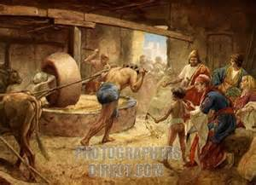
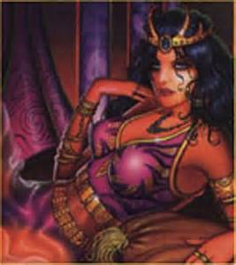
The Leaven of Herod
Satan never shows you the end of your sin!!!!
Hebrews 11:25
Choosing rather to suffer affliction with the people of God, than to enjoy the pleasures of sin for a season;
Proverbs 5:3
For the lips of a strange woman drop as an honeycomb, and her mouth is smoother than oil:
Pro 5:4 But in the end she is bitter as wormwood, sharp as a two-edged and devouring sword.
Sin promises much and delivers little.
Proverbs 5:11-14 (NLIV)
Afterward you will groan in anguish when disease consumes your body, ¹² and you will say, “How I hated discipline! If only I had not demanded my own way! ¹³ Oh, why didn’t I listen to my teachers? Why didn’t I pay attention to those who gave me instruction? ¹⁴ I have come to the brink of utter ruin, and now I must face public disgrace.”

Slide 39
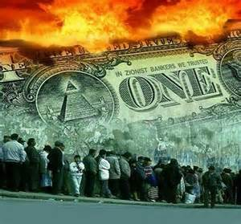
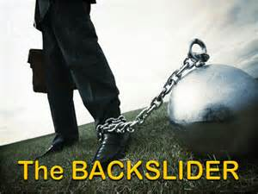
The Leaven of Herod
Those who love and Cherish this world will partake of the Judgments coming on this world.
Rev 18:4 And I heard another voice from heaven, saying, Come out of her, my people, that ye be not partakers of her sins, and that ye receive not of her plagues.
Rev 18:5 For her sins have reached unto heaven, and God hath remembered her iniquities.
Demas
popular
2Ti 4:10 For Demas hath forsaken me, having loved this present world, and is departed unto Thessalonica; Crescens to Galatia, Titus unto Dalmatia.

Slide 40
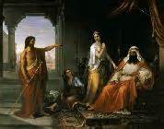
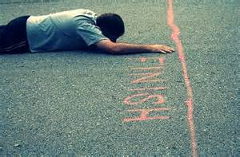
The Leaven of Herod
The Leaven of Herod is to hear and not Do!
Mark 6:20
For Herod feared John, knowing that he was a just man and an holy, and observed him; and when he heard him, he did many things, and heard him gladly.
Matthew 3:8
Bring forth therefore fruits meet for repentance:
Jas 1:22 (GNB) Do not deceive yourselves by just listening to his word; instead, put it into practice.

Slide 41
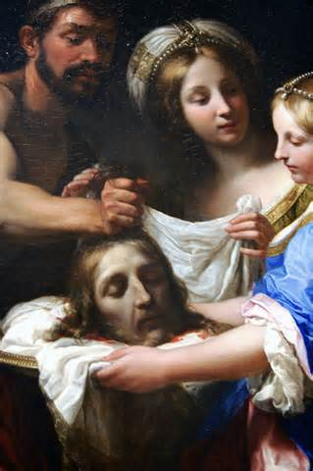
The Leaven of Herod
Herod who loved the world feared man more than God, He was like Saul who feared the people.
Matthew 14:6-9
But when Herod's birthday was kept, the daughter of Herodias danced before them, and pleased Herod. [7] Whereupon he promised with an oath to give her whatsoever she would ask. [8] And she, being before instructed of her mother, said, Give me here John Baptist's head in a charger. [9] And the king was sorry: nevertheless for the oath's sake, and them which sat with him at meat, he commanded it to be given her.
Proverbs 29:25
The fear of man bringeth a snare: but whoso putteth his trust in the Lord shall be safe.
Proverbs 10:27
The fear of the Lord prolongeth days: but the years of the wicked shall be shortened

Slide 42
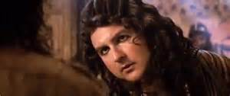
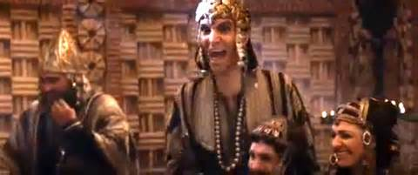
The Leaven of Herod
On Jesus' last day of his earthly life he was sent to Herod who mocked him.
Luke 23:8-11
And when Herod saw Jesus, he was exceeding glad: for he was desirous to see him of a long season, because he had heard many things of him; and he hoped to have seen some miracle done by him. [9] Then he questioned with him in many words; but he answered him nothing. [10] And the chief priests and scribes stood and vehemently accused him. [11] And Herod with his men of war set him at nought, and mocked him, and arrayed him in a gorgeous robe, and sent him again to Pilate.
One of the Judgments of God is when he doesn't answer you!!!!
1 Samuel 28:6
And when Saul enquired of the Lord, the Lord answered him not, neither by dreams nor by Urim, nor by prophets.
Hosea 4:17
Ephraim is joined to idols: let him alone.

Slide 43
The cure ? Live for God
Pro 1:20 Wisdom crieth without; she uttereth her voice in the streets:
Pro 1:21 She crieth in the chief place of concourse, in the openings of the gates: in the city she uttereth her words, saying,
Pro 1:22 How long, ye simple ones, will ye love simplicity? and the scorners delight in their scorning, and fools hate knowledge?
Pro 1:23 Turn you at my reproof: behold, I will pour out my spirit unto you, I will make known my words unto you.
Pro 1:24 Because I have called, and ye refused; I have stretched out my hand, and no man regarded;
Pro 1:25 But ye have set at naught all my counsel, and would none of my reproof:
Pro 1:26 I also will laugh at your calamity; I will mock when your fear cometh;
Pro 1:27 When your fear cometh as desolation, and your destruction cometh as a whirlwind; when distress and anguish cometh upon you.
Pro 1:28 Then shall they call upon me, but I will not answer; they shall seek me early, but they shall not find me:
Pro 1:29 For that they hated knowledge, and did not choose the fear of the LORD:
Pro 1:30 They would none of my counsel: they despised all my reproof.
Pro 1:31 Therefore shall they eat of the fruit of their own way, and be filled with their own devices.
Pro 1:32 For the turning away of the simple shall slay them, and the prosperity of fools shall destroy them.
Pro 1:33 But whoso hearkeneth unto me shall dwell safely, and shall be quiet from fear of evil.

