Slide 1
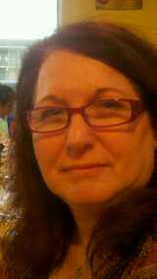
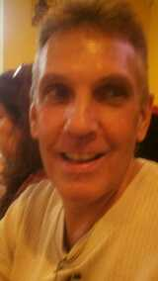
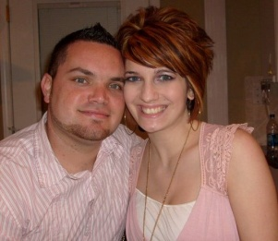
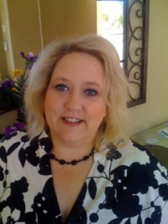
The Feast of Passover
Psa 89:15 Blessed (happy, fortunate, to be envied) are the people who know the joyful sound [who understand and appreciate the spiritual blessings symbolized by the feasts]; they walk, O Lord, in the light and favor of Your countenance!
1Co 5:7 …. For even Christ our Passover is sacrificed for us:
“Gods people are safe under the Blood of the Lamb”
What does Passover mean? “Pesach” Translated Passover means a Passing over.

Slide 2
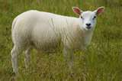
Passover
Exo 12:5 Your lamb shall be without blemish, a male of the first year: ye shall take it out from the sheep, or from the goats:
The Lamb had to be a Male & without Blemish
Rom 5:18 Consequently, just as the result of one trespass was condemnation for all men, so also the result of one act of righteousness was justification that brings life for all men.
Rom 5:19 For just as through the disobedience of the one man (ADAM) the many were made sinners, so also through the obedience of the one man (JESUS) the many will be made righteous.

Slide 3
Passover
Exo 12:5 Your lamb shall be without blemish, a male of the first year: ye shall take it out from the sheep, or from the goats:
Exo 12:6 And ye shall keep it up until the fourteenth day of the same month: and the whole assembly of the congregation of Israel shall kill it in the evening.
The Lamb had to be “watched” for 4 days to ensure he was without blemish

Slide 4
The Feast of Passover
A New Beginning through the Blood
4 Days Watch
7th now 1st Mth
Nisan 10th Day
Nisan 14th Day
Exo 12:6 ….kill it (The Lamb) in the evening. Literally “Between the Evenings” or 3:00 PM
It’s amazing he’s perfect!
I can’t find anything wrong with Him!

Slide 5
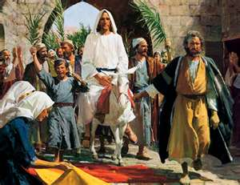
On The 10th day of Nisan 2000 years later
Jesus rides into Jersulem on a donkey
10 Day of Nisan
2000 Years Later
10 Day of Nisan
Joh 1:29, …Behold the Lamb of God, which taketh away the sin of the world.
Mat 21:5 Tell ye the daughter of Zion, Behold, thy king cometh unto thee, meek, and sitting upon an ass, and a colt the foal of an ass.
Mat 21:6 And the disciples went, and did as Jesus commanded them,
Mat 21:7 And brought the ass, and the colt, and put on them their clothes, and they set him thereon.
Mat 21:8 And a very great multitude spread their garments in the way; others cut down branches from the trees, and strewed them in the way.

Slide 6
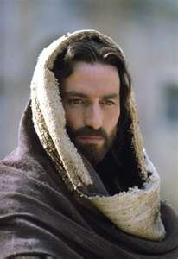
Jesus Gods Perfect Lamb
The lamb after 4 days was like a family Pet “Your lamb shall be without blemish”
1Pe 1:18 Forasmuch as ye know that ye were not redeemed with corruptible things, as silver and gold, from your vain conversation received by tradition from your fathers;
1Pe 1:19 But with the precious blood of Christ, as of a lamb without blemish and without spot:
For 4 Days Jesus is in Jerusalem and is found without fault
Joh 14:30 Hereafter I will not talk much with you: for the prince of this world cometh, and hath nothing in me.
Joh 8:46 Who of you convicts Me of wrongdoing or finds Me guilty of sin? Then if I speak truth, why do you not believe Me [trust Me, rely on, and adhere to Me]?

Slide 7
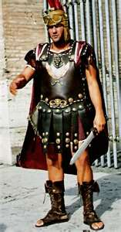
Jesus Gods Perfect Lamb
Pilate found no fault in him
officers to the chief priests
Joh 18:28 Then led they Jesus from Caiaphas unto the hall of judgment: and it was early; and they themselves went not into the judgment hall, lest they should be defiled; but that they might eat the passover.
Joh 18:38 Pilate saith unto him, What is truth? And when he had said this, he went out again unto the Jews, and saith unto them, I find in him no fault at all.
Joh 7:45 Then came the officers to the chief priests and Pharisees; and they said unto them, Why have ye not brought him?
Joh 7:46 The officers answered, Never man spake like this man.

Slide 8
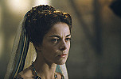
Jesus Gods Perfect Lamb
Pilates wife declared him to be Just
Herod examined Jesus
Luk 23:8 And when Herod saw Jesus, he was exceeding glad: for he was desirous to see him of a long season, because he had heard many things of him; and he hoped to have seen some miracle done by him. Luk 23:9 Then he questioned with him in many words; but he answered him nothing.
Luk 23:10 And the chief priests and scribes stood and vehemently accused him.
Luk 23:11 And Herod with his men of war set him at naught, and mocked him, and arrayed him in a gorgeous robe, and sent him again to Pilate.
Luk 23:12 And the same day Pilate and Herod were made friends together: for before they were at enmity between themselves.
Mat 27:19 When he was set down on the judgment seat, his wife sent unto him, saying, Have thou nothing to do with that just man: for I have suffered many things this day in a dream because of him.

Slide 9
Jesus Gods Perfect Lamb
Judas declared him to be Innocent
The Repentant Thief declared him innocent
Luk 23:39 And one of the malefactors which were hanged railed on him, saying, If thou be Christ, save thyself and us.
Luk 23:40 But the other answering rebuked him, saying, Dost not thou fear God, seeing thou art in the same condemnation?
Luk 23:41 And we indeed justly; for we receive the due reward of our deeds: but this man hath done nothing amiss.
Luk 23:42 And he said unto Jesus, Lord, remember me when thou comest into thy kingdom.
Mat 27:3 Then Judas, which had betrayed him, when he saw that he was condemned, repented himself, and brought again the thirty pieces of silver to the chief priests and elders,
Mat 27:4 Saying, I have sinned in that I have betrayed the innocent blood. And they said, What is that to us? see thou to that.

Slide 10
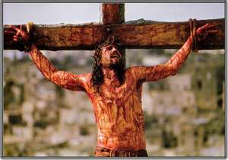
Jesus Gods Perfect Lamb
Mat 27:54 Now when the centurion, and they that were with him, watching Jesus, saw the earthquake, and those things that were done, they feared greatly, saying, Truly this was the Son of God.

Slide 11
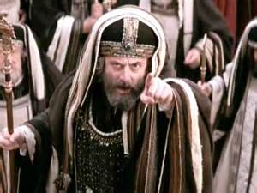
Passover The Lamb without Spot 4th Day
Exo 12:6 And ye shall keep it up until the fourteenth day of the same month: and the whole assembly of the congregation of Israel shall kill it in the evening.
“Between the Evenings” or 3:00 PM
Nisan 14th Day Passover
THE SANHEDRIN, THE PRIESTS, AND THE PEOPLE OF Israel all clamoured for the crucifixion of Jesus and for his blood to be shed.
Joh 11:49 And one of them, named Caiaphas, being the high priest that same year, said unto them, Ye know nothing at all,
Joh 11:50 Nor consider that it is expedient for us, that one man should die for the people, and that the whole nation perish not.
Joh 11:51 And this spake he not of himself: but being high priest that year, he prophesied that Jesus should die for that nation;

Slide 12
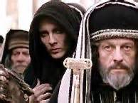
Passover The Lamb without Spot 4th Day
Exo 12:6 And ye shall keep it up until the fourteenth day of the same month: and the whole assembly of the congregation of Israel shall kill it in the evening.
satan
THE SANHEDRIN, THE PRIESTS, AND THE PEOPLE OF Israel all clamoured for the crucifixion of Jesus and for his blood to be shed.
Joh 19:14 And it was the preparation of the passover, and about the sixth hour: and he saith unto the Jews, Behold your King!
Joh 19:15 But they cried out, Away with him, away with him, crucify him. Pilate saith unto them, Shall I crucify your King? The chief priests answered, We have no king but Caesar.

Slide 13
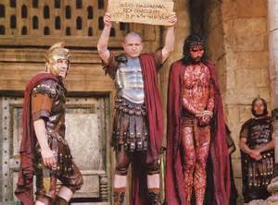
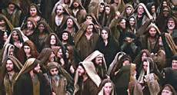
Passover The Lamb without Spot 4th Day
Exo 12:6 And ye shall keep it up until the fourteenth day of the same month: and the whole assembly of the congregation of Israel shall kill it in the evening.
THE SANHEDRIN, THE PRIESTS, AND THE PEOPLE OF Israel all clamoured for the crucifixion of Jesus and for his blood to be shed.
Mat 27:25 Then answered all the people, and said, His blood be on us, and on our children.

Slide 14
Passover The Lamb without Spot 4th Day
Exo 12:6 And ye shall keep it up until the fourteenth day of the same month: and the whole assembly of the congregation of Israel shall kill it in the evening.
“Between the Evenings” or 3:00 PM
Nisan 14th Day
Mat 27:46 And about the ninth hour (3 PM) Jesus cried with a loud voice, saying, Eli, Eli, lama sabachthani? that is to say, My God, my God, why hast thou forsaken me?
Mat 27:50 Jesus, when he had cried again with a loud voice, yielded up the ghost.

Slide 15
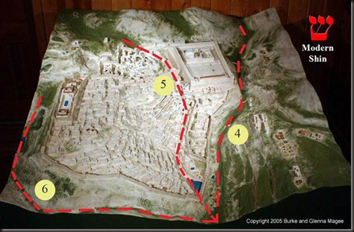
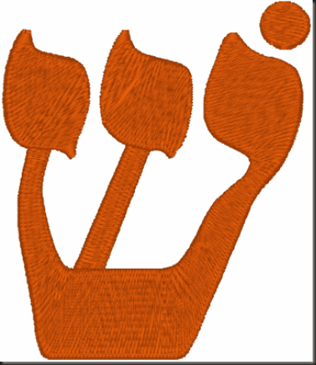
Passover The Lamb without Spot 4th Day
Deu 16:6 But at the place which the LORD thy God shall choose to place his name in, there thou shalt sacrifice the passover at even, at the going down of the sun, at the season that thou camest forth out of Egypt.
God’s Name is on Jerusalem
It is interesting that the three valleys form the Hebrew letter “Shin.”
A modern version of the Shin is shown in the picture.
The Shin represents God’s name as in “El Shaddai” (God Almighty).
“Shaddai,” written in Hebrew ydc, denotes the character of God, that He is Almighty.

Slide 16
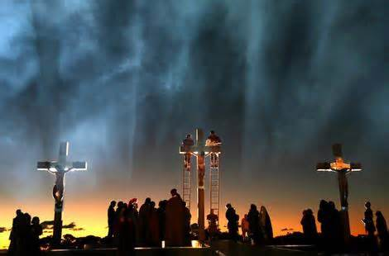
Passover The Lamb without Spot 4th Day
Deu 16:6 But at the place which the LORD thy God shall choose to place his name in, there thou shalt sacrifice the passover at even, at the going down of the sun, at the season that thou camest forth out of Egypt.
Luk 23:44 And it was about the sixth hour, and there was a darkness over all the earth until the ninth hour.
Luk 23:45 And the sun was darkened, and the veil of the temple was rent in the midst.
Nisan 14th Day
Amo 8:9 And it shall come to pass in that day, saith the Lord GOD, that I will cause the sun to go down at noon, and I will darken the earth in the clear day:
Amo 8:10 And I will turn your feasts into mourning, and all your songs into lamentation; and I will bring up sackcloth upon all loins, and baldness upon every head; and I will make it as the mourning of an only son, and the end thereof as a bitter day.

Slide 17
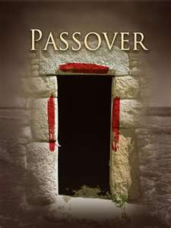
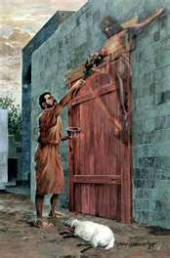
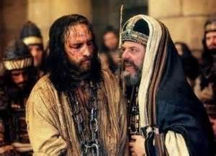
Passover The Lamb without Spot 4th Day
Exo 12:7 And they shall take of the blood, and strike it on the two side posts and on the upper door post of the houses, wherein they shall eat it.
Joh 18:22 And when he had thus spoken, one of the officers which stood by struck Jesus with the palm of his hand, saying, Answerest thou the high priest so?
Joh 10:9 I am the door: by me if any man enter in, he shall be saved, and shall go in and out, and find pasture.

Slide 18
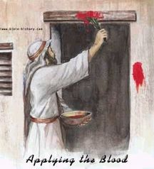
Passover The Lamb without Spot 4th Day
Exo 12:7 And they shall take of the blood, and strike it on the two side posts and on the upper door post of the houses, wherein they shall eat it.
The Blood must be applied to the lintel and the door posts
Jesus is the Lamb and the Blood sprinkled door, in his death he is the Lamb. In his ressurection he is the only door into God’s presence.

Slide 19
Passover The Lamb without Spot 4th Day
Exo 12:7 And they shall take of the blood, and strike it on the two side posts and on the upper door post of the houses, wherein they shall eat it.
Hyssop- Is symbolic of Faith
The Blood must be applied in a triune manner
1Jn 5:7 For there are three that bear record in heaven, the Father, the Word, and the Holy Ghost: and these three are one.
1Jn 5:8 And there are three that bear witness in earth, the spirit, and the water, and the blood: and these three agree in one.
In Jesus’s death he is the lamb in his ressurection he is the doorway into God’s presence

Slide 20
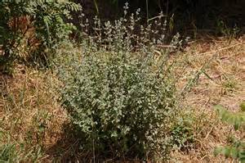
Passover The Lamb without Spot 4th Day
Exo 12:7 And they shall take of the blood, and strike it on the two side posts and on the upper door post of the houses, wherein they shall eat it.
Hyssop- Is symbolic of Faith
The Blood must be applied with Hyssop
Exo 12:22 And ye shall take a bunch of hyssop, and dip it in the blood that is in the basin, and strike the lintel and the two side posts with the blood that is in the basin; and none of you shall go out at the door of his house until the morning.
It speaks of Humility and the lowliness of faith which applies the Blood of Jesus

Slide 21
Passover The Lamb without Spot 4th Day
The Blood was never applied to the Bottom of the door we are not to trample underfoot the precious Blood of Jesus!
Heb 10:29 How much worse (sterner and heavier) punishment do you suppose he will be judged to deserve who has spurned and [thus] trampled underfoot the Son of God, and who has considered the covenant blood by which he was consecrated common and unhallowed, thus profaning it and insulting and outraging the [Holy] Spirit [Who imparts] grace (the unmerited favor and blessing of God)? [Exod. 24:8.]
Jesus is my Passover!

Slide 22
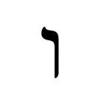
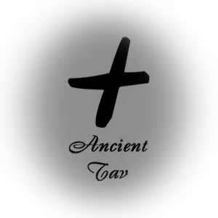
Passover The Lamb without Spot 4th Day
Exo 12:13 And the blood shall be to you for a token upon the houses where ye are: and when I see the blood, I will pass over you, and the plague shall not be upon you to destroy you, when I smite the land of Egypt.
אות- 'ôth –oth -Token
Probably from H225 (in the sense of appearing); a signal (literally or figuratively), as a flag, beacon, monument, omen, prodigy, evidence, etc.: - mark, miracle, (en-) sign, token.
Ancient Hebrew would look like this
Modern Hebrew
אות
Vav
Aleph
Tav

Slide 23
Passover The Lamb without Spot 4th Day
אות- 'ôth –oth -Token
Probably from H225 (in the sense of appearing); a signal (literally or figuratively), as a flag, beacon, monument, omen, prodigy, evidence, etc.: - mark, miracle, (en-) sign, token.
Tav
Vav
Aleph
To the sign
Nailed
The Leader
This is the word used for the Blood of the Lamb placed on the door post on Passover Exodus 12:13 “Token” or Sign

Slide 24
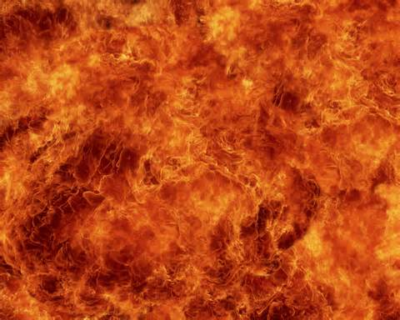
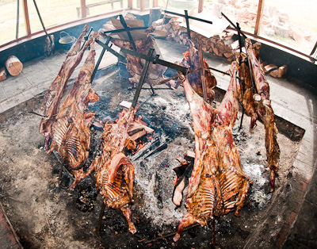
How the Passover Lamb must be Eaten
Exo 12:8 And they shall eat the flesh in that night, roast with fire, and unleavened bread; and with bitter herbs they shall eat it.
Exo 12:46 In one house shall it be eaten; thou shalt not carry forth aught of the flesh abroad out of the house; neither shall ye break a bone thereof.
The Lamb should be eaten roasted with fire & no bones Broken
Heb 12:29 For our God is a consuming fire.
Rev 1:15 And his feet like unto fine brass, as if they burned in a furnace; and his voice as the sound of many waters.
Notice the roasting sticks are crosses

Slide 25
How the Passover Lamb must be Eaten
Exo 12:8 And they shall eat the flesh in that night, roast with fire, and unleavened bread; and with bitter herbs they shall eat it.
Exo 12:46 In one house shall it be eaten; thou shalt not carry forth aught of the flesh abroad out of the house; neither shall ye break a bone thereof.
Psa 34:20 He keepeth all his bones: not one of them is broken.
Joh 19:32 Then came the soldiers, and broke the legs of the first, and of the other which was crucified with him.
Joh 19:33 But when they came to Jesus, and saw that he was dead already, they broke not his legs:

Slide 26
Passover The Lamb without Spot 4th Day
Jesus experienced the fire of the cross
Exo 12:8 And they shall eat the flesh in that night, roast with fire,
Nisan 14th Day
Mat 20:18 Behold, we go up to Jerusalem: and the Son of man shall be betrayed unto the chief priests and unto the scribes, and they shall condemn him to death,
Mat 20:19 And shall deliver him to the Gentiles to mock, and to scourge, and to crucify him: and the third day he shall rise again.

Slide 27
How the Passover Lamb must be Eaten
Exo 12:8 And they shall eat the flesh in that night, roast with fire, and unleavened bread; and with bitter herbs they shall eat it.
Joh 6:53 Then Jesus said unto them, Verily, verily, I say unto you, Except ye eat the flesh of the Son of man, and drink his blood, ye have no life in you.
Mat 20:22 But Jesus answered and said, Ye know not what ye ask. Are ye able to drink of the cup that I shall drink of, and to be baptized with the baptism that I am baptized with? They say unto him, We are able.

