Slide 1
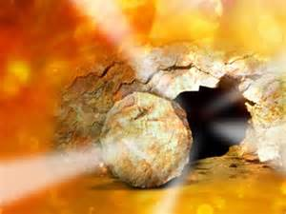
The Feasts of The Lord
The Bible calls the Feasts the “Feasts of the Lord” not the Feasts of Israel
The Feasts are for every believer not just Israel
Lev 23:2 Speak unto the children of Israel, and say unto them, Concerning the feasts of the LORD, which ye shall proclaim to be holy convocations, even these are my feasts.

Slide 2
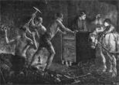
Introducing the Feasts
Reading Gives us Breadth Study gives us Depth
My back hurts!
Glory!
Here’s another truth I dug out!
Quit complaining and keep studying
Job 28:1 Surely there is a vein for the silver, and a place for gold where they fine it.
Job 28:2 Iron is taken out of the earth, and brass is molten out of the stone.

Slide 3
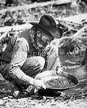
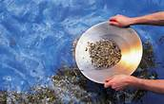
Introducing the Feasts
Reading is like Panning for Gold you never hit the mother load you just get surface truth!
Just more surface truth
Did you get anything!
2Ti 2:15 (AMP) Study and be eager and do your utmost to present yourself to God approved (tested by trial), a workman who has no cause to be ashamed, correctly analyzing and accurately dividing [rightly handling and skillfully teaching] the Word of Truth.

Slide 4
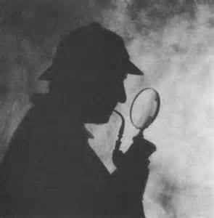
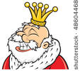
Introducing the Feasts
Believers are Kings and Priests
Pro 25:2 It is the glory of God to conceal a thing: but the honor of kings is to search out a matter.
Hmm… Feast means appointed time!
I knew that!!!
Rev 1:5 And from Jesus Christ, who is the faithful witness, and the first begotten of the dead, and the prince of the kings of the earth. Unto him that loved us, and washed us from our sins in his own blood,
Rev 1:6 And hath made us kings and priests unto God and his Father; to him be glory and dominion forever and ever. Amen.

Slide 5
Introducing the Feasts
The Feasts of the Lord outlined in Leviticus 23
Spring Feasts
1. PASSOVER
2. FEAST OF UNLEAVENED BREAD
3. FEAST OF FIRSTFRUITS
4. FEAST OF PENTECOST (WEEKS)
Fall Feasts
5. FEAST OF TRUMPETS
6. DAY OF ATONEMENT
7. FEAST OF TABERNACLES

Slide 6
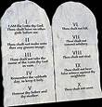
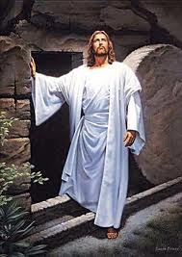
Introducing the Feasts
Lack of Understanding of the Feasts has Robbed the church of historical, typical and prophetical truth
Knowledge
The Old Testament is the New Testament Concealed. The New Testament is the Old Testament Revealed
Fulfillment

Slide 7
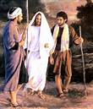
Introducing the Feasts
The Feasts of the Lord Reveal our Redemption in Christ
Awesome Truth
Wow that’s Revelation
Luk 24:27 And beginning at Moses and all the prophets, he expounded unto them in all the Scriptures the things concerning himself.
Luk 24:32 And they said one to another, Did not our heart burn within us, while he talked with us by the way, and while he opened to us the Scriptures?

Slide 8
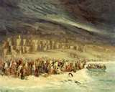
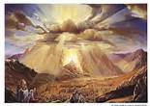
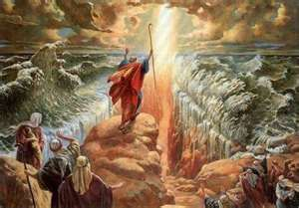
God gave Israel the Mosiac Law Feasts
When God brought Israel out of Egypt “The House of Bondage” he gave them the complete order of approach to his presence. This order was found in the Mosiac covenant. At Mt Sinai God brought the people into his covenant relationship. (The Law was Given on Pentecost)
Exo 19:1 In the third month, when the children of Israel were gone forth out of the land of Egypt, the same day came they into the wilderness of Sinai.
The 14th of Nissan / April
The 17th of Nissan / April
The 3rd Month 50 Days Later
The Feast of Passover
The Feast of First Fruits
The Feast of Pentecost

Slide 9
God gave Israel the Mosiac Law
Exo 19:4 Ye have seen what I did unto the Egyptians, and how I bore you on eagles' wings, and brought you unto myself.
Exo 19:5 Now therefore, if ye will obey my voice indeed, and keep my covenant, then ye shall be a peculiar treasure unto me above all people: for all the earth is mine:
Exo 19:6 And ye shall be unto me a kingdom of priests, and a holy nation. These are the words which thou shalt speak unto the children of Israel.
The 14th of Nissan / April
The 17th of Nissan / April
The 3rd Month 50 Days Later
The Feast of Passover
The Feast of First Fruits
The Feast of Pentecost

Slide 10
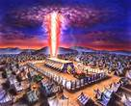
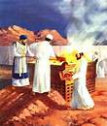
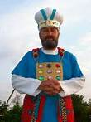
There are 5 Major parts of the Mosiac Covenant
The Law, Moral ,Civil, and Dietary
The Tabernacle of Moses
The Feasts of the Lord
Spring Feasts
1. PASSOVER
2. FEAST OF UNLEAVENED BREAD
3. FEAST OF FIRSTFRUITS
4. FEAST OF PENTECOST (WEEKS)
Fall Feasts
5. FEAST OF TRUMPETS
6. DAY OF ATONEMENT
7. FEAST OF TABERNACLES
The Sacrificial Offerings
The Aaronic and Levitical Priesthood

Slide 11
The Feasts are the part we are studing
Psa 89:15 (AMP) Blessed (happy, fortunate, to be envied) are the people who know the joyful sound [who understand and appreciate the spiritual blessings symbolized by the feasts]; they walk, O Lord, in the light and favor of Your countenance!
I love the Feasts
The only Feast I know is Chick-Fil-A
Many believers are like Israel and count the study of the Feasts as a strange thing
Hos 8:12 (AMP) I wrote for him the ten thousand things of My law, but they are counted as a strange thing [as something which does not concern him].

Slide 12
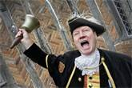
Why Study the Feasts of The Lord
The Bible says we are to proclaim the Feasts
Lev 23:4 These are the set feasts or appointed seasons of the Lord, holy convocations you shall proclaim at their stated times:
Study the Feasts!
Strongs 7121- qârâ‘ kaw-raw‘
The idea of accosting a person met); to call out to (that is, properly address by name, but used in a wide variety of applications): - bewray [self], that are bidden, call (for, forth, self, upon), cry (unto), (be) famous, guest, invite, mention, (give) name, preach, (make) proclaim (-ation), pronounce, publish, read, renowned, say.

Slide 13
Why Study the Feasts of The Lord
They are part of the scriptures
2Ti 3:16 Every Scripture is God-breathed (given by His inspiration) and profitable for instruction, for reproof and conviction of sin, for correction of error and discipline in obedience, [and] for training in righteousness (in holy living, in conformity to God's will in thought, purpose, and action),
2Ti 3:17 So that the man of God may be complete and proficient, well fitted and thoroughly equipped for every good work.
2) They are a shadow of things to come
Col 2:16 Therefore let no one sit in judgment on you in matters of food and drink, or with regard to a feast day or a New Moon or a Sabbath.
Col 2:17 Such [things] are only the shadow of things that are to come, and they have only a symbolic value. But the reality (the substance, the solid fact of what is foreshadowed, the body of it) belongs to Christ.

Slide 14
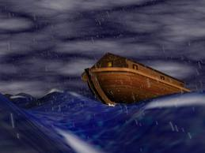
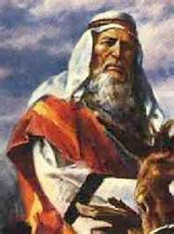
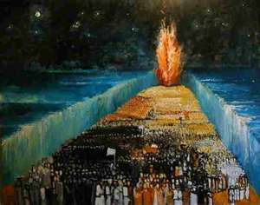
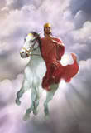
Why Study the Feasts of The Lord
2) Shadow continued
Heb 10:1 (AMP) FOR SINCE the Law has merely a rude outline (foreshadowing) of the good things to come--instead of fully expressing those things--it can never by offering the same sacrifices continually year after year make perfect those who approach [its altars].
3) They are a Prophetic types
1Co 10:6 Now these things are examples (warnings and admonitions) for us not to desire or crave or covet or lust after evil and carnal things as they did. [Num. 11:4, 34.]
Mat 5:17 Do not think that I have come to do away with or undo the Law or the Prophets; I have come not to do away with or undo but to complete and fulfill them.
Mat 5:18 For truly I tell you, until the sky and earth pass away and perish, not one smallest letter nor one little hook [identifying certain Hebrew letters] will pass from the Law until all things [it foreshadows] are accomplished.

Slide 15
Why Study the Feasts of The Lord
4) They are for our Learning
Rom 15:4 For whatever was thus written in former days was written for our instruction, that by [our steadfast and patient] endurance and the encouragement [drawn] from the Scriptures we might hold fast to and cherish hope.
5) Christ Jesus fulfilled them literally
Luk 24:25 And [Jesus] said to them, O foolish ones [sluggish in mind, dull of perception] and slow of heart to believe (adhere to and trust in and rely on) everything that the prophets have spoken!
Luk 24:26 Was it not necessary and essentially fitting that the Christ (the Messiah) should suffer all these things before entering into His glory (His majesty and splendor)?
Luk 24:27 Then beginning with Moses and [throughout] all the Prophets, He went on explaining and interpreting to them in all the Scriptures the things concerning and referring to Himself.

Slide 16
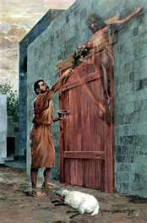
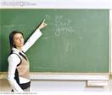
Why Study the Feasts of The Lord
6) They are part of the law which is a “Schoolmaster” to lead us to Christ.
Gal 3:24 So that the Law served [to us Jews] as our trainer [our guardian, our guide to Christ, to lead us] until Christ [came], that we might be justified (declared righteous, put in right standing with God) by and through faith.
I get it! Jesus is my Passover!
Are you Listening? The Feasts point us to Christ
7) They reveal more about Christ
Heb 10:7 Then I said, Behold, here I am, coming to do Your will, O God--[to fulfill] what is written of Me in the volume of the Book. [Ps. 40:6-8.]
Psa 40:6 Sacrifice and offering You do not desire, nor have You delight in them; You have given me the capacity to hear and obey [Your law, a more valuable service than] burnt offerings and sin offerings [which] You do not require.
Psa 40:7 Then said I, Behold, I come; in the volume of the book it is written of me;
Psa 40:8 I delight to do Your will, O my God; yes, Your law is within my heart. [Heb. 10:5-9.]

Slide 17
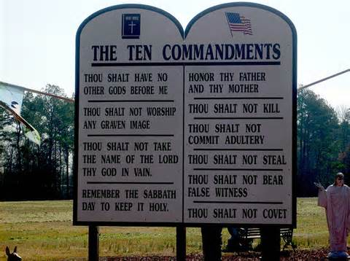
Why Study the Feasts of The Lord
8) We study the external Truth “Law” to know Internal truth
Rom 2:20 You are] a corrector of the foolish, a teacher of the childish, having in the Law the embodiment of knowledge and truth-
Heb 1:1 IN MANY separate revelations [each of which set forth a portion of the Truth] and in different ways God spoke of old to [our] forefathers in and by the prophets,
Heb 1:2 [But] in the last of these days He has spoken to us in [the person of a] Son, Whom He appointed Heir and lawful Owner of all things, also by and through Whom He created the worlds and the reaches of space and the ages of time [He made, produced, built, operated, and arranged them in order].

Slide 18
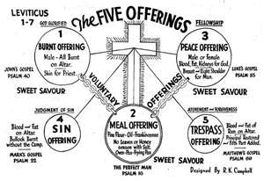
Why Study the Feasts of The Lord
9) The Feasts reveal God’s patterns
Heb 9:23 By such means, therefore, it was necessary for the [earthly] copies of the heavenly things to be purified, but the actual heavenly things themselves [required far] better and nobler sacrifices than these.
Heb 9:24 For Christ (the Messiah) has not entered into a sanctuary made with [human] hands, only a copy and pattern and type of the true one, but [He has entered] into heaven itself, now to appear in the [very] presence of God on our behalf.

Slide 19
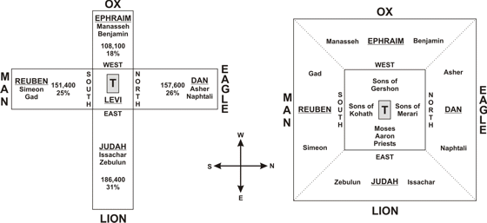
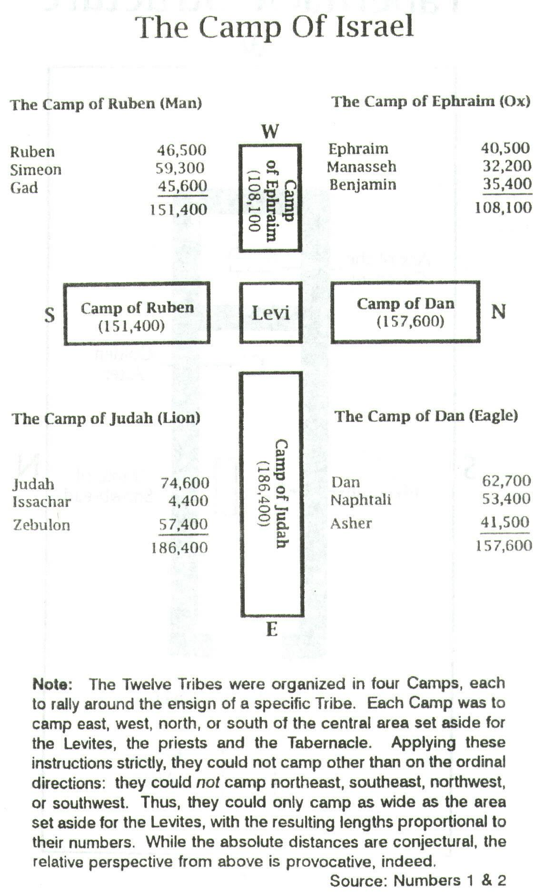
Why Study the Feasts of The Lord
9) patterns Continued
Heb 8:5 [But these offer] service [merely] as a pattern and as a foreshadowing of [what has its true existence and reality in] the heavenly sanctuary. For when Moses was about to erect the tabernacle, he was warned by God, saying, See to it that you make it all [exactly] according to the copy (the model) which was shown to you on the mountain. [Exod. 25:40.]
Heb 9:9 Seeing that that first [outer portion of the] tabernacle was a parable (a visible symbol or type or picture of the present age). In it gifts and sacrifices are offered, and yet are incapable of perfecting the conscience or of cleansing and renewing the inner man of the worshiper

Slide 20
Why Study the Feasts of The Lord
10) The Feasts reveal the Ministry of Christ. Three Times a year the Israelites were commanded to go up to Jerusalem for these three feasts. The Feasts reveal the First coming of Christ “Passover”. Through the Church age “Pentecost” to the second coming of Christ “Tabernacles”.
The Feast of Passover
1st Coming
The Feast of Pentecost
Church Age
The Feast of Tabernacles
2nd Coming

Slide 21
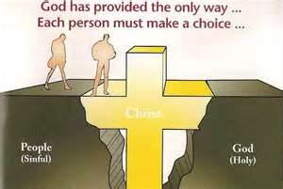
Why Study the Feasts of The Lord
11) The truth in the Feasts reveal Present truth
2Pe 1:12 So I intend always to remind you about these things, although indeed you know them and are firm in the truth that [you] now [hold].
Mat 4:4 But He replied, It has been written, Man shall not live and be upheld and sustained by bread alone, but by every word that comes forth from the mouth of God. [Deut. 8:3.]

Slide 22
Why Study the Feasts of The Lord
12) We will experience all the feasts as the End-time generation
2Ch 8:13 A certain number every day, offering as Moses commanded for the Sabbaths, the New Moons, and the solemn feast days three times in the year--the Feasts of Unleavened Bread, of Weeks, and of Tabernacles.
Rev 2:7 He who is able to hear, let him listen to and give heed to what the Spirit says to the assemblies (churches). To him who overcomes (is victorious), I will grant to eat [of the fruit] of the tree of life, which is in the paradise of God. [Gen. 2:9; 3:24.]
The Feast of Passover
1st Coming
The Feast of Pentecost
Church Age
The Feast of Tabernacles
2nd Coming

Slide 23
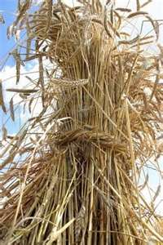
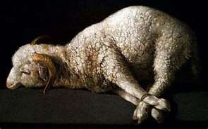
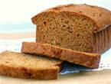
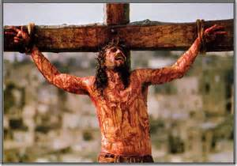
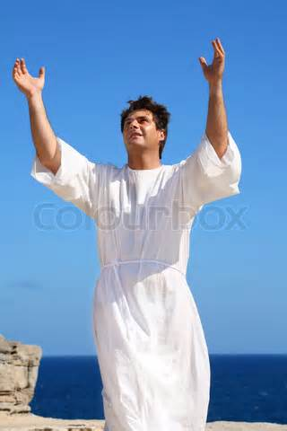
Why Study the Feasts of The Lord
13) God’s principle is 1st the Natural and then that which is spiritual.
1Co 15:46 But it is not the spiritual life which came first, but the physical and then the spiritual.
1Co 15:47 The first man [was] from out of earth, made of dust (earthly-minded); the second Man [is] the Lord from out of heaven. [Gen. 2:7.]
1st the Natural lamb then the Spiritual DivineLamb
1st the Natural loaves of leaven then the Spiritual loaves
1st the Physical sheafs of wheat then the Spiritual

Slide 24
Why Study the Feasts of The Lord
14) The Feasts of the Lord use the Language of Creation as the language of Redemption.
Rom 1:20 For ever since the creation of the world His invisible nature and attributes, that is, His eternal power and divinity, have been made intelligible and clearly discernible in and through the things that have been made (His handiworks). So [men] are without excuse [altogether without any defense or justification], [Ps. 19: 1-4.]
15) The Feast show us the letter of the law was swallowed up in the Spirit of life.
2Co 4:18 Since we consider and look not to the things that are seen but to the things that are unseen; for the things that are visible are temporal (brief and fleeting), but the things that are invisible are deathless and everlasting.

Slide 25
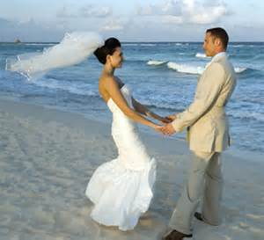
Why Study the Feasts of The Lord
16) The Feasts are God’s Dress Rehearsals.
Lev 23:2 Speak unto the children of Israel, and say unto them, Concerning the feasts of the LORD, which ye shall proclaim to be holy convocations, even these are my feasts.
Lev 23:2 … holy convocations-mik-raw‘ also a rehearsal: - assembly,
Lets stop rehearsing and get Married!
Rehearsing is Fun!

Slide 26
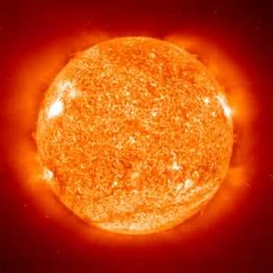
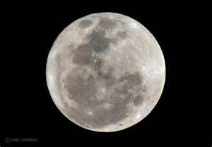
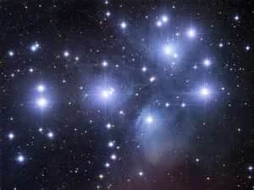
Why Study the Feasts of The Lord
17) The Sun & Moon and Stars are signs “Signals” of the Feasts. (Appointed Times)
Sun
Moon
Stars
Gen 1:14 And God said, Let there be lights in the firmament of the heaven to divide the day from the night; and let them be for signs, and for seasons, and for days, and years:

Slide 27
Why Study the Feasts of The Lord
17) The Sun & Moon and Stars are signs “Signals” of the Feasts. (Appointed Times)
17) The Sun & Moon and Stars are signs of the Feasts.
Sun
Moon
Stars
Gen 1:14 ….and let them be for signs, …
Signs- oth - a signal (literally or figuratively), as a flag, beacon, monument, omen, prodigy, evidence, etc.: - mark, miracle, (en-) sign, token.

Slide 28
Why Study the Feasts of The Lord
17) The Sun & Moon and Stars are signs “Signals” of the Feasts. (Appointed Times)
17) The Sun & Moon and Stars are signs “Signals” of the Feasts.
Sun
Moon
Stars
Gen 1:14 …. and for seasons, and for days, and years:… Seasons - mô‛êd- an appointment, that is, a fixed time or season; specifically a festival; the place of meeting; also a signal (as appointed beforehand): - feast

Slide 29
Why Study the Feasts of The Lord
17) The Sun & Moon and Stars are signs “Signals” of the Feasts. (Appointed Times)
17) The Sun & Moon and Stars are signs of the Feasts.
Sun
Moon
Stars
Lev 23:2 Speak unto the children of Israel, and say unto them, Concerning the feasts of the LORD, which ye shall proclaim to be holy convocations, even these are my feasts.

Slide 30
Why Study the Feasts of The Lord
17) The Sun & Moon and Stars are signs “Signals” of the Feasts. (Appointed Times)
17) The Sun & Moon and Stars are signs of the Feasts.
Sun
Moon
Stars
Lev 23:2 … holy convocations-mik-raw‘
also a rehearsal: - assembly,

Slide 31
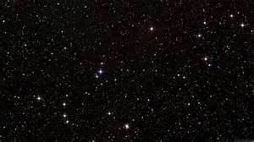
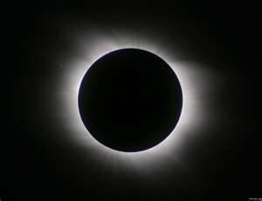
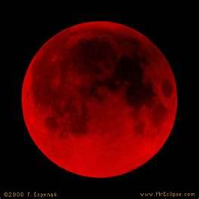
Why Study the Feasts of The Lord
The prophet Joel Prophesied of the signs “Signals” in the heavens for his second coming
Sun
Blood Moon
Joel_2:31 The sun shall be turned into darkness, and the moon into blood, before the great and the terrible day of the LORD come.

Slide 32
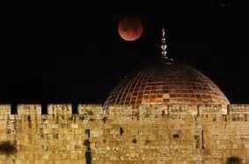
Why Study the Feasts of The Lord
Blood moon over Jerusalem February 2008

Slide 33
Why Study the Feasts of The Lord
Blood Moons (Tetrad) 4 Blood moons in 2 years
7 Tetrads in the 1500s but none on the Feast Days
None in the 1700s
None in the 1600s
None in the 1800s

Slide 34
Blood Moons Tetrad
Passover
Tabernacles
1949
Isa 66:8 Who hath heard such a thing? who hath seen such things? Shall the earth be made to bring forth in one day? or shall a nation be born at once? for as soon as Zion travailed, she brought forth her children.
1950
Israel Becomes a Nation in 1948

Slide 35
Blood Moons Tetrad
Passover
Tabernacles
1967
2Th 2:3 ……., and that man of sin be revealed, the son of perdition;
2Th 2:4 Who opposeth and exalteth himself above all that is called God, or that is worshipped; so that he as God sitteth in the temple of God, shewing himself that he is God.
1968
Israel Regains the Temple Mount wins 6 day war

Slide 36
Blood Moons Tetrad
Passover
Tabernacles
2014
2015
Don’t know Be Ready!

Slide 37
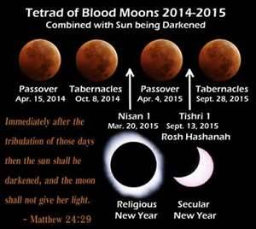

Slide 38
There are 7 Feasts of The Lord
Spring Feasts
1. PASSOVER
2. FEAST OF UNLEAVENED BREAD
3. FEAST OF FIRSTFRUITS
4. FEAST OF PENTECOST (WEEKS)
Fall Feasts
5. FEAST OF TRUMPETS
6. DAY OF ATONEMENT
7. FEAST OF TABERNACLES

Slide 39
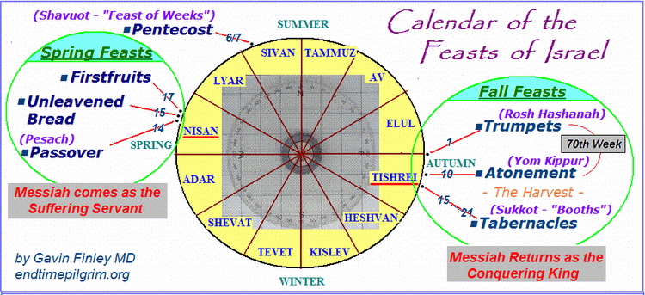

Slide 40
Time Line of Feasts
Passover
Unleavened Bread
Sheaf of First Fruits
Nisan
Pentecost
Sivan
Interval
Tammuz
Av
Elul
Trumpets
Day of Atonement
Tabernacles
Tishrei
1st Month
3rd Month
4th,5th,6th Months
7th Month

Slide 41
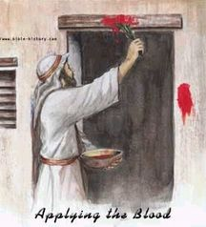
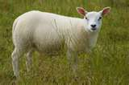
Passover
PASSOVER Lev 23:4 'These are the LORD's appointed feasts, the sacred assemblies you are to proclaim at their appointed times:
Lev 23:5 The LORD's Passover begins at twilight on the fourteenth day of the first month.
Passover is the Feast of Salvation . In both Testaments the Blood of the Lamb delivers from slavery. The Jew from Physical slavery in Egypt and the Christian from the Slavery of the Egypt of Sin
1Co 5:7 ….. For even Christ our Passover is sacrificed for us:

Slide 42
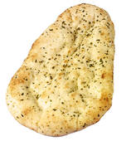
FEAST OF UNLEAVENED BREAD
2. FEAST OF UNLEAVENED BREAD
Lev 23:6 On the fifteenth day of that month the LORD's Feast of Unleavened Bread begins; for seven days you must eat bread made without yeast.
1Co 5:7 Purge out therefore the old leaven, that ye may be a new lump, as ye are unleavened.
1Co 5:8 Therefore let us keep the feast, not with old leaven, neither with the leaven of malice and wickedness; but with the unleavened bread of sincerity and truth.
Leaven of the Pharisees
Leaven of the Sadduccees
Leaven of Herod
Leaven of Galatia
Leaven of Corinth

Slide 43
3 Loaves of Bread
1Co 10:32 Give none offense, neither to the Jews, nor to the Gentiles, nor to the church of God:
Jews
Church
Gentiles
Leaven is usually used in a negative sense except here
Mat 13:33 Another parable spake he unto them; The kingdom of heaven is like unto leaven, which a woman took, and hid in three measures of meal, till the whole was leavened.

Slide 44
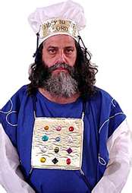
FEAST OF FIRSTFRUITS
FEAST OF FIRSTFRUITS
Lev 23:10 Speak unto the children of Israel, and say unto them, When ye be come into the land which I give unto you, and shall reap the harvest thereof, then ye shall bring a sheaf of the first fruits of your harvest unto the priest:
Lev 23:11 And he shall wave the sheaf before the LORD, to be accepted for you: on the morrow after the sabbath the priest shall wave it.
1Co 15:20 But now is Christ risen from the dead, and become the firstfruits of them that slept.

Slide 45
FEAST OF PENTECOST (WEEKS)
FEAST OF PENTECOST (WEEKS)
Lev 23:15 'From the day after the Sabbath, the day you brought the sheaf of the wave offering, count off seven full weeks.
Lev 23:16 Count off fifty days up to the day after the seventh Sabbath, and then present an offering of new grain to the LORD.
Lev 23:17 From wherever you live, bring two loaves made of two-tenths of an ephah of fine flour, baked with yeast, as a wave offering of firstfruits to the LORD.
Luk 24:49 And, behold, I send the promise of my Father upon you: but tarry ye in the city of Jerusalem, until ye be endued with power from on high.
2Co 3:17 Now the Lord is that Spirit: and where the Spirit of the Lord is, there is liberty.

Slide 46
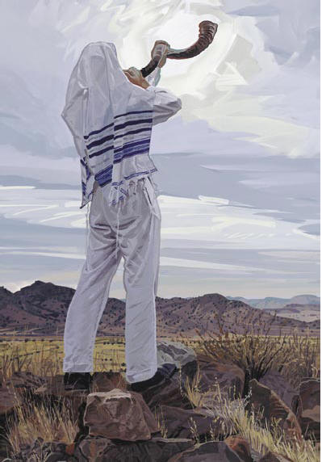
The Feast of Trumpets
Lev 23:23 And the LORD spoke unto Moses, saying,
Lev 23:24 Speak unto the children of Israel, saying, In the seventh month, in the first day of the month, shall ye have a sabbath, a memorial of blowing of trumpets, a holy convocation.
Lev 23:25 Ye shall do no servile work therein: but ye shall offer an offering made by fire unto the LORD.
1Co 14:8 For if the trumpet give an uncertain sound, who shall prepare himself to the battle?
Mat 24:31 And he shall send his angels with a great sound of a trumpet, and they shall gather together his elect from the four winds, from one end of heaven to the other.

Slide 47
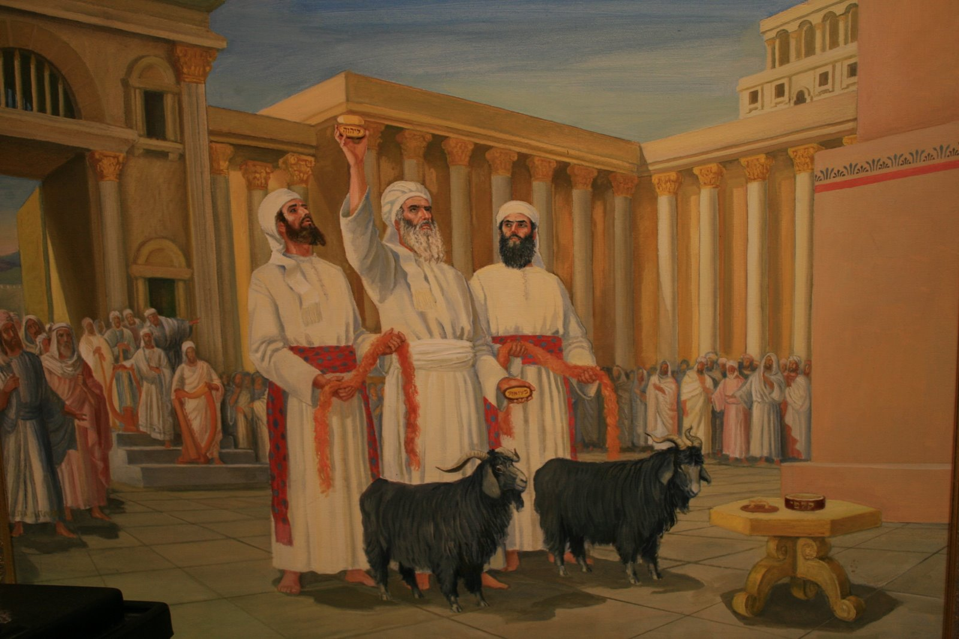
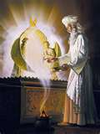
Day of Atonement
Lev 23:26 And the LORD spoke unto Moses, saying,
Lev 23:27 Also on the tenth day of this seventh month there shall be a day of atonement: it shall be a holy convocation unto you; and ye shall afflict your souls, and offer an offering made by fire unto the LORD.
Lev 23:28 And ye shall do no work in that same day: for it is a day of atonement, to make an atonement for you before the LORD your God.
Lev 23:29 For whatsoever soul it be that shall not be afflicted in that same day, he shall be cut off from among his people.
Heb 9:11 But Christ being come a high priest of good things to come, by a greater and more perfect tabernacle, not made with hands, that is to say, not of this building;
Heb 9:12 Neither by the blood of goats and calves, but by his own blood he entered in once into the holy place, having obtained eternal redemption for us.
Isa 1:18 Come now, and let us reason together, saith the LORD: though your sins be as scarlet, they shall be as white as snow; though they be red like crimson, they shall be as wool.

Slide 48
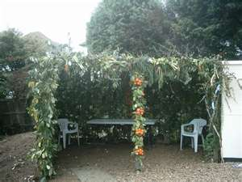
The Feast of Tabernacles
Lev 23:39 Also in the fifteenth day of the seventh month, when ye have gathered in the fruit of the land, ye shall keep a feast unto the LORD seven days: on the first day shall be a sabbath, and on the eighth day shall be a sabbath.
Lev 23:40 And ye shall take you on the first day the boughs of goodly trees, branches of palm trees, and the boughs of thick trees, and willows of the brook; and ye shall rejoice before the LORD your God seven days.
Lev 23:41 And ye shall keep it a feast unto the LORD seven days in the year. It shall be a statute forever in your generations: ye shall celebrate it in the seventh month.
Lev 23:42 Ye shall dwell in booths seven days; all that are Israelites born shall dwell in booths:
Lev 23:43 That your generations may know that I made the children of Israel to dwell in booths, when I brought them out of the land of Egypt: I am the LORD your God.
Rev 21:3 And I heard a great voice out of heaven saying, Behold, the tabernacle of God is with men, and he will dwell with them, and they shall be his people, and God himself shall be with them, and be their God.

