Slide 1
There are 4 Springs Feasts of the Lord
Spring Feasts
1. PASSOVER
2. FEAST OF UNLEAVENED BREAD
3. FEAST OF FIRSTFRUITS
4. FEAST OF PENTECOST (WEEKS)

Slide 2
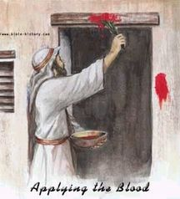
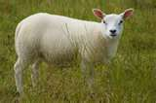
Passover
PASSOVER Lev 23:4 'These are the LORD's appointed feasts, the sacred assemblies you are to proclaim at their appointed times:
Lev 23:5 The LORD's Passover begins at twilight on the fourteenth day of the first month.
Passover is the Feast of Salvation . In both Testaments the Blood of the Lamb delivers from slavery. The Jew from Physical slavery in Egypt and the Christian from the Slavery of the Egypt of Sin
1Co 5:7 ….. For even Christ our Passover is sacrificed for us:

Slide 3
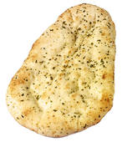
FEAST OF UNLEAVENED BREAD
2. FEAST OF UNLEAVENED BREAD
Lev 23:6 On the fifteenth day of that month the LORD's Feast of Unleavened Bread begins; for seven days you must eat bread made without yeast.
1Co 5:7 Purge out therefore the old leaven, that ye may be a new lump, as ye are unleavened.
1Co 5:8 Therefore let us keep the feast, not with old leaven, neither with the leaven of malice and wickedness; but with the unleavened bread of sincerity and truth.
Leaven of the Pharisees
Leaven of the Sadducees
Leaven of Herod
Leaven of Galatia
Leaven of Corinth

Slide 4
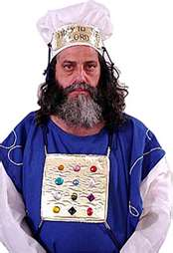
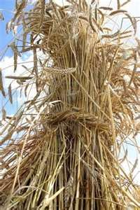
FEAST OF FIRSTFRUITS
FEAST OF FIRSTFRUITS
Lev 23:10 Speak unto the children of Israel, and say unto them, When ye be come into the land which I give unto you, and shall reap the harvest thereof, then ye shall bring a sheaf of the first fruits of your harvest unto the priest:
Lev 23:11 And he shall wave the sheaf before the LORD, to be accepted for you: on the morrow after the sabbath the priest shall wave it.

Slide 5
FEAST OF PENTECOST
The New Testament Sign of Pentecost was and is tongues
Act 2:1 And when the day of Pentecost was fully come, they were all with one accord in one place.
Act 2:2 And suddenly there came a sound from heaven as of a rushing mighty wind, and it filled all the house where they were sitting.
Act 2:3 And there appeared unto them cloven tongues like as of fire, and it satupon each of them.
Act 2:4 And they were all filled with the Holy Ghost, and began to speak with other tongues, as the Spirit gave them utterance.

Slide 6
The Feasts of The Lord
The Three Fall Feasts
5. FEAST OF TRUMPETS
6. DAY OF ATONEMENT
7. FEAST OF TABERNACLES

Slide 7
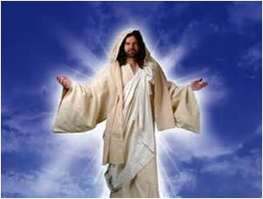
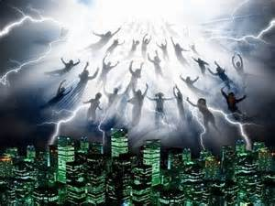
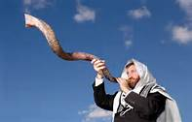
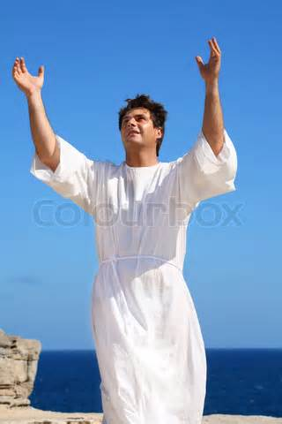
FEAST OF TRUMPETS
Yom Teruah-means the day of the Awaking blast of the shofar, the rams horn. It is believed by the Jews to be the day of the first resurrection of the dead. It is in the seventh month.

Slide 8
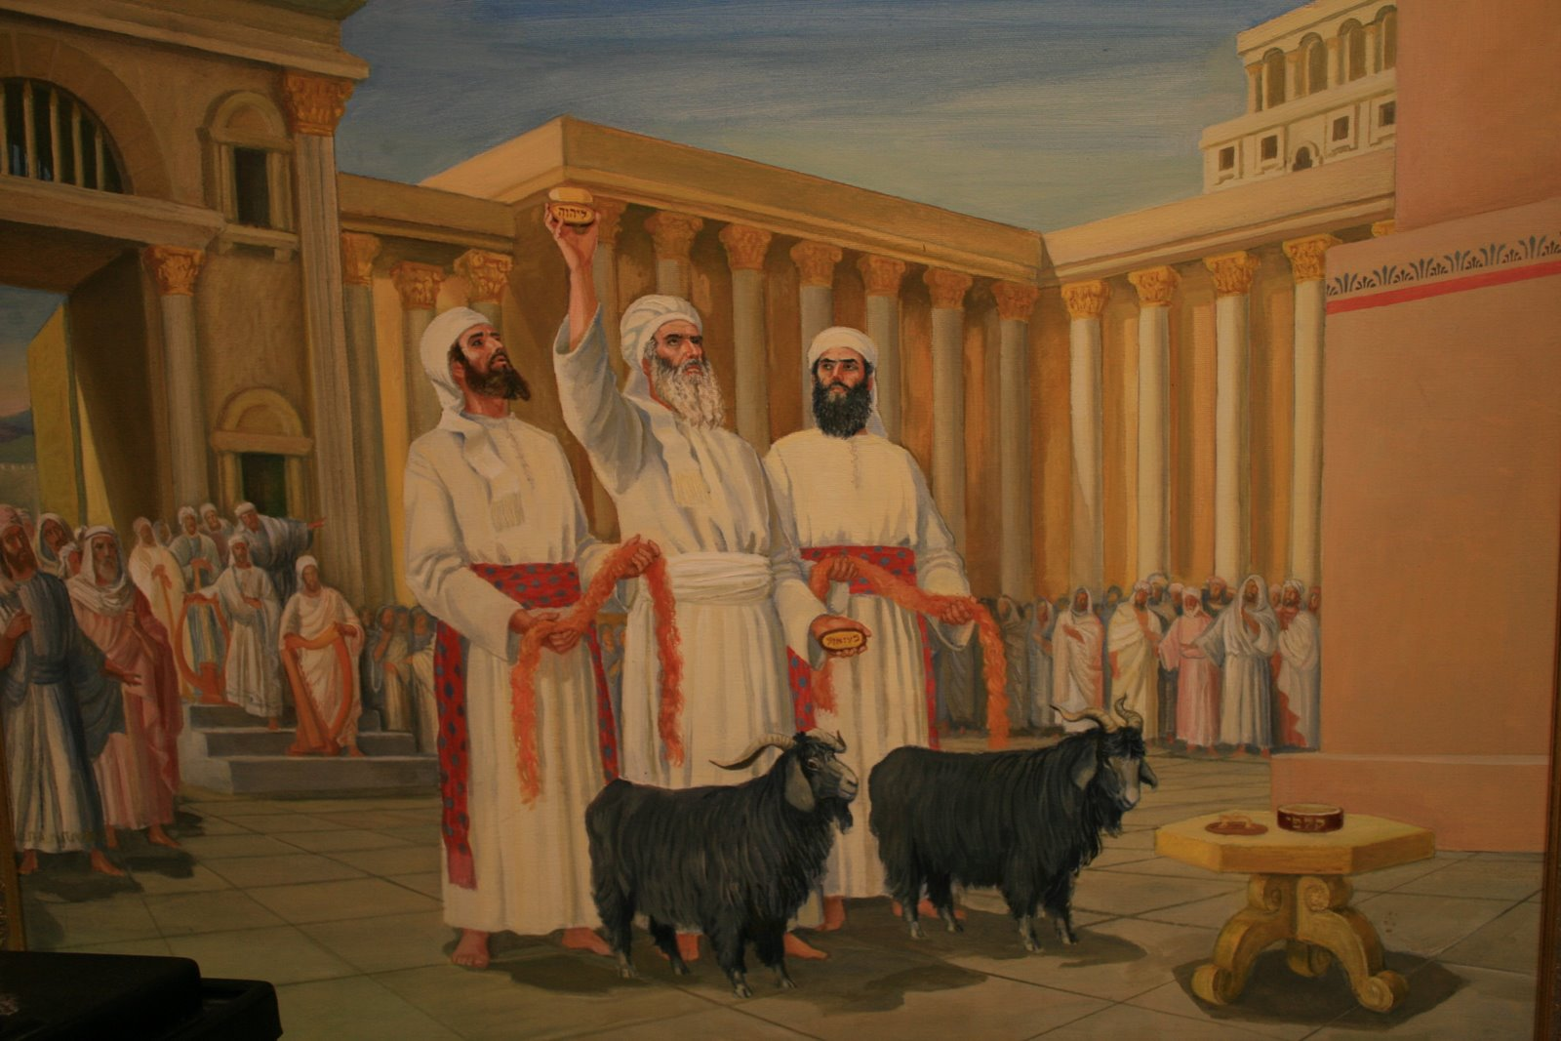
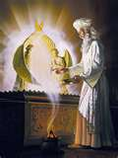
Day of Atonement
The Day of Atonement was the most solemn of all days in Israel. This was the day of National and Sanctuary Cleansing.
Atonement means- kâphar -kaw-far‘- to cover (specifically with bitumen); figuratively to expiate or condone, to placate or cancel: - appease, make (an) atonement, cleanse, disannul, forgive, be merciful, pacify, pardon, to pitch, purge (away), put off, (make) reconcile (-liation).

Slide 9
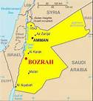
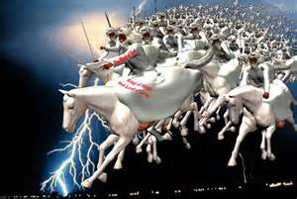
Day of Atonement
Isa 61:2 to proclaim the year of the LORD's favor and the day of vengeance of our God, to comfort all who mourn,

Slide 10
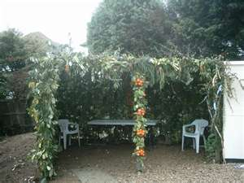
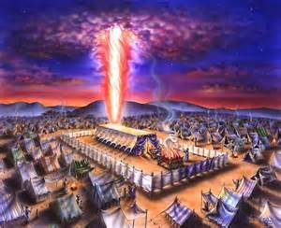
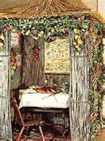
The Feast of Tabernacles
The Feast of Sukkot
The Feast of Booths
Tents also speak of our earthly lives
Lev 23:36 Seven days ye shall offer an offering made by fire unto the LORD: on the eighth day shall be a holy convocation unto you; and ye shall offer an offering made by fire unto the LORD: it is a solemn assembly; and ye shall do no servile work therein.
Lev 23:39 Also in the fifteenth day of the seventh month, when ye have gathered in the fruit of the land, ye shall keep a feast unto the LORD seven days: on the first day shall be a sabbath, and on the eighth day shall be a sabbath.
Lev 23:40 And ye shall take you on the first day the boughs of goodly trees, branches of palm trees, and the boughs of thick trees, and willows of the brook; and ye shall rejoice before the LORD your God seven days.
Lev 23:41 And ye shall keep it a feast unto the LORD seven days in the year. It shall be a statute forever in your generations: ye shall celebrate it in the seventh month.
Lev 23:42 Ye shall dwell in booths seven days; all that are Israelites born shall dwell in booths:
Lev 23:43 That your generations may know that I made the children of Israel to dwell in booths, when I brought them out of the land of Egypt: I am the LORD your God.
The Booths spoke of a temporary dwelling place, enroute to the promised land, and permanent dwelling
Booth- sûkkâh
sook-kaw'
Feminine of H5520; a hut or lair: - booth, cottage, covert, pavilion, tabernacle, tent.
2Pe 1:13 Yea, I think it meet, as long as I am in this tabernacle, to stir you up by putting you in remembrance;
2Pe 1:14 Knowing that shortly I must put off this my tabernacle, even as our Lord Jesus Christ hath showed me.
Heb 11:9 By faith he sojourned in the land of promise, as in a strange country, dwelling in tabernacles with Isaac and Jacob, the heirs with him of the same promise:

Slide 11
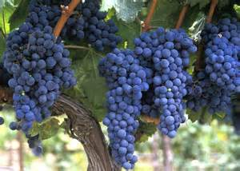
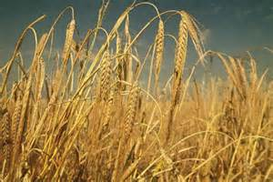
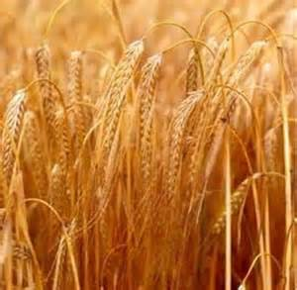
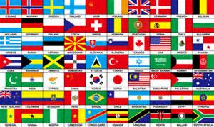
The Feast of Nations
The Feast of Ingathering
The Day of Atonement or Yom Kippur
Was National Cleansing of Sin
5 days Later on Tabernacles 70 Bullocks were sacrificed for the nations
Barley symbolizes the Jewish Harvest which happened at First Fruits
Wheat is also a picture of the Gentile Harvest which Happened at Pentecost
The Jews Believed there are 70 different types of people, 70 different tonques and seventy different nations on the earth
Luk 10:1 After these things the Lord appointed other seventy also, and sent them two and two before his face into every city and place, whither he himself would come.
Rev 14:16 And he that sat on the cloud thrust in his sickle on the earth; and the earth was reaped.
Rev 14:17 And another angel came out of the temple which is in heaven, he also having a sharp sickle.
Rev 14:18 And another angel came out from the altar, which had power over fire; and cried with a loud cry to him that had the sharp sickle, saying, Thrust in thy sharp sickle, and gather the clusters of the vine of the earth; for her grapes are fully ripe.
The Final Harvest is a fruit harvest or Grapes
This Title points to the Final Harvest, which was the final ingathering at the end of the year

Slide 12
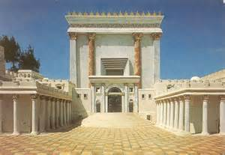
The Feast of Tabernacles
Passover reveals the Son of God
Pentecost reveals the Holy Spirit
The Feast of Trumpets, Yom Kippur
And Tabernacles reveals The Father
1. Passover
2. Pentecost
3. Tabernacles
Deu 16:16 Three times in a year shall all thy males appear before the LORD thy God in the place which he shall choose; in the feast of unleavened bread, and in the feast of weeks, and in the feast of tabernacles: and they shall not appear before the LORD empty:
Deu 16:17 Every man shall give as he is able, according to the blessing of the LORD thy God which he hath given thee.
Why would God command his people to come to Jerusalem 3 times a year? He wanted his people to see when his son the messiah was born, when his son the messiah would die, and the outpouring of the Holy Spirit.
For Tabernacles Josephus recorded that 2 & ½ million Jews would have been in Jerusalem for Tabernacles which is our Lords Birthday Party

Slide 13
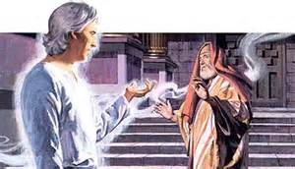
Jesus was Born of the Feast of Tabernacles
Luk 1:5 There was in the days of Herod, the king of Judea, a certain priest named Zacharias, of the course of Abijah: and his wife was of the daughters of Aaron, and her name was Elisabeth.
Luk 1:6 And they were both righteous before God, walking in all the commandments and ordinances of the Lord blameless.
We can determine when Jesus was born by looking at the birth of his cousin John the Baptist

Slide 14
Jesus was Born of the Feast of Tabernacles
Luk 1:7 And they had no child, because that Elisabeth was barren, and they both were now well stricken in years.
Luk 1:8 And it came to pass, that while he executed the priest's office before God in the order of his course,
Luk 1:9 According to the custom of the priest's office, his lot was to burn incense when he went into the temple of the Lord.
Luk 1:5 There was in the days of Herod, the king of Judea, a certain priest named Zacharias, of the course of Abijah: and his wife was of the daughters of Aaron, and her name was Elisabeth.
Luk 1:6 And they were both righteous before God, walking in all the commandments and ordinances of the Lord blameless.
Zechariah was of the eighth order, (1 Chronicles 24:7-19) and this means that, with Passover and Pentecost factored in, Abijah’s first course of service in the Temple would have fallen the week immediately after Pentecost.

Slide 15
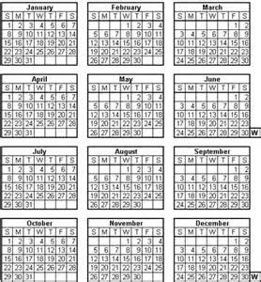
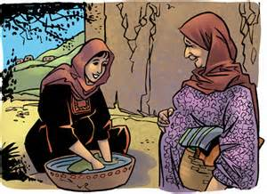
Jesus was Born of the Feast of Tabernacles
Luk 1:26 And in the sixth month the angel Gabriel was sent from God unto a city of Galilee, named Nazareth,
Luk 1:27 To a virgin espoused to a man whose name was Joseph, of the house of David; and the virgin's name was Mary.
9 months from December is September or the first week of October (Tabernacles)
1
4
2
5
3
You have been gaining a lot of weight. What are you eating?
6
3
7
4
8
Because of Passover 3rd course would
Serve the 4th week
Because of Pentecost Zachrias would have stayed in Jerusalem and served this week as well
1
3
2
Luk 1:10 And the whole multitude of the people were praying without at the time of incense.
Luk 1:11 And there appeared unto him an angel of the Lord standing on the right side of the altar of incense.
Luk 1:16 And many of the children of Israel shall he turn to the Lord their God.
Luk 1:17 And he shall go before him in the spirit and power of Elijah, to turn the hearts of the fathers to the children, and the disobedient to the wisdom of the just; to make ready a people prepared for the Lord.
Luk 1:23 And it came to pass, that, as soon as the days of his ministration were accomplished, he departed to his own house.
Luk 1:24 And after those days his wife Elisabeth conceived, and hid herself five months, saying,
Luk 1:25 Thus hath the Lord dealt with me in the days wherein he looked on me, to take away my reproach among men.
Luk 1:12 And when Zacharias saw him, he was troubled, and fear fell upon him.
Luk 1:13 But the angel said unto him, Fear not, Zacharias: for thy prayer is heard; and thy wife Elisabeth shall bear thee a son, and thou shalt call his name John.
Luk 1:14 And thou shalt have joy and gladness; and many shall rejoice at his birth.
Luk 1:15 For he shall be great in the sight of the Lord, and shall drink neither wine nor strong drink; and he shall be filled with the Holy Ghost, even from his mother's womb.
5
6
And, it was during this first tour of duty in 3 B.C. that Zechariah had the following encounter:
4

Slide 16
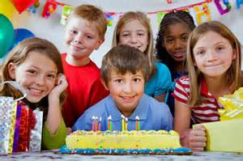
Jesus was Born of the Feast of Tabernacles
God commanded that we rejoice and celebrate his sons birthday
Deu 16:13 Thou shalt observe the feast of tabernacles seven days, after that thou hast gathered in thy corn and thy wine:
Deu 16:14 And thou shalt rejoice in thy feast, thou, and thy son, and thy daughter, and thy manservant, and thy maidservant, and the Levite, the stranger, and the fatherless, and the widow, that are within thy gates.

Slide 17
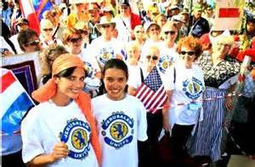
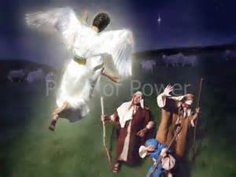
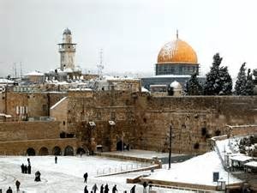
Jesus was Born of the Feast of Tabernacles
Jerusalem in Winter - You will not find shepherds in the field
What do women use to look young in winter?
What do you call a gangsta snowman
Psa 118:14 The LORD is my strength and song, and is become my salvation. (y^{e}shû‛âh- yesh-oo'-aw)
Feminine passive participle of H3467; something saved, that is, (abstractly) deliverance; hence aid, victory, prosperity: - deliverance, health, help (-ing), salvation, save, saving (health), welfare.
I don’t know
I don’t know?
Psa 118:15 The voice of rejoicing and salvation is in the tabernacles of the righteous: the right hand of the LORD doeth valiantly.
Psa 118:16 The right hand of the LORD is exalted: the right hand of the LORD doeth valiantly.
Luk 2:8 And there were in the same country shepherds abiding in the field, keeping watch over their flock by night.
Luk 2:9 And, lo, the angel of the Lord came upon them, and the glory of the Lord shone round about them: and they were sore afraid.
Luk 2:10 And the angel said unto them, Fear not: for, behold, I bring you good tidings of great joy, which shall be to all people.
Luk 2:11 For unto you is born this day in the city of David a Savior, which is Christ the Lord.
Froze-T
Cold Cream!

Slide 18
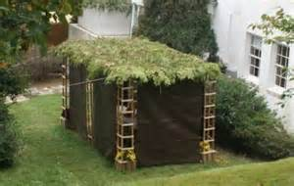
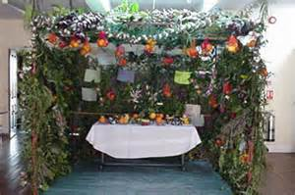
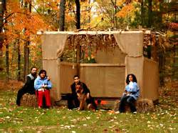
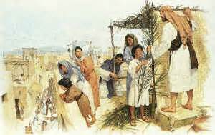
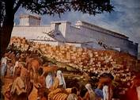
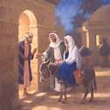
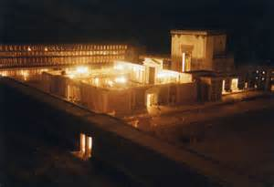
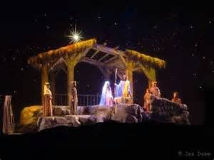
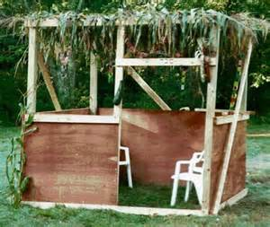
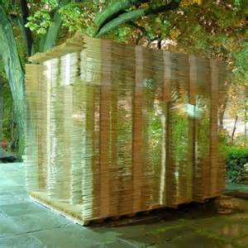
Jesus was Born of the Feast of Tabernacles
During the Feast of Tabernacles the Priests would use Strips of old priestly garments for wicks to light the lamp stands. Jesus’s relatives were priests. (Zachrias & Elizabeth) Jesus was literally wrapped in strips of priestly garments of the feasts of Tabernacles
Swaddling -Sparganoō spar-gan-o'-o
From σπάργανον sparganon (a strip; from a derivative of the base of G4682 meaning to strap or wrap with strips); to swathe (an infant after the Oriental custom): - wrap in swaddling clothes.
Luk 2:4 And Joseph also went up from Galilee, out of the city of Nazareth, into Judea, unto the city of David, which is called Bethlehem; because (he was of the house and lineage of David:)
Luk 2:5 To be taxed with Mary his espoused wife, being great with child.
Luk 2:6 And so it was, that, while they were there, the days were accomplished that she should be delivered.
Luk 2:7 And she brought forth her firstborn son, and wrapped him in swaddling clothes, and laid him in a manger; because there was no room for them in the inn.
When Jesus was born there would have been thousands of sukkahs erected all over to celebrate Tabernacles
Technically Jerusalem borders Bethlehem where Jesus was born. There would have been 2 & ½ million Jews There to celebrate Tabernacles
Joh 9:5 As long as I am in the world, I am the light of the world.

Slide 19
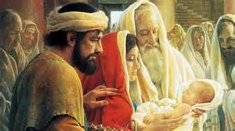
Jesus was Born of the Feast of Tabernacles
He created Us!
Remember the Feast of Tabernacles was eight days. The Eighth day was a Sabbath
Luk 2:21 And when eight days were accomplished for the circumcising of the child, his name was called JESUS, which was so named of the angel before he was conceived in the womb.
On the Eighth day Jesus of this feast Jesus or Yeshuah was in the temple Beimg circumcised fulfilling the Abrahamic Covenant by shedding his blood

Slide 20
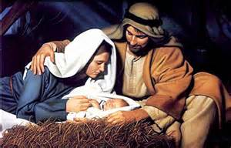
Jesus was Born of the Feast of Tabernacles
Dwelt- skēnoō skay-no'-o
From G4636; to tent or encamp, that is, (figuratively) to occupy (as a mansion) or (specifically) to reside (as God did in the Tabernacle of old, a symbol fo protection and communion): - dwell.
Joh 1:14 And the Word was made flesh, and dwelt among us, (and we beheld his glory, the glory as of the only begotten of the Father,) full of grace and truth.

