Slide 1
Fasting
The Lord has called every Believer to become disciples of Jesus Christ
The word Disciple in the Greek is -mathetes (manthano); a learner, i.e. pupil :- disciple. matheteuo (mathetes); to become a pupil; to disciple, i.e. enroll as scholar :- be disciple, instruct, teach.
Fasting is Part of Being a Disciple
Jan 6 –Jan 27th

Slide 2
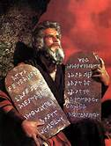
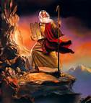
Fasting
The Bible records many different circumstances, types and length of fasts.
There are 3 Types of Fast in Scripture
1(Absolute Fast, 2)Normal Fast and 3) Partial Fast
Absolute Fast: Moses Fasted 40 days twice, Once to receive the commandments of God the Second time Interceding for the Israel's sin
Deuteronomy 9:9 (KJV) ⁹ When I was gone up into the mount to receive the tables of stone, even the tables of the covenant which the LORD made with you, then I abode in the mount forty days and forty nights, I neither did eat bread nor drink water: Absolute Fast

Slide 3
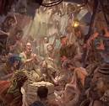
Fasting
Normal Fast: Paul fasted 14 days and God saved everyone on his ship
Act 27:33 As day was about to dawn, Paul urged them all to take some food, saying, "Today is the fourteenth day that you have continued in suspense and without food, having taken nothing.
Act 27:34 Therefore I urge you to take some food. For it will give you strength, for not a hair is to perish from the head of any of you." Normal Fast
Paul Practiced fasting Often
2Co 11:27 In weariness and painfulness, in watchings often, in hunger and thirst, in fastings often, in cold and nakedness.

Slide 4
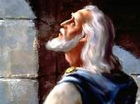
Fasting
Partial Fast: Daniel Practiced a Partial fast for 21
Dan 10:2 In those days I Daniel was mourning three full weeks.
Dan 10:3 I ate no pleasant bread, neither came flesh nor wine in my mouth, neither did I anoint myself at all, till three whole weeks were fulfilled.

Slide 5
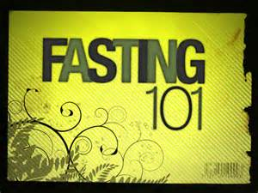
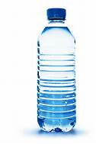
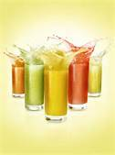
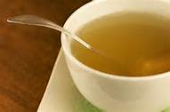
Fasting
As a Church I am advocating Normal and Partial Fast for the Beginning of this year
Some of us may want to combine a Normal Fast with a Partial Fast. Some of us can only do a partial fast due to health reasons.
To combine both Fasts you would start out on a normal fast and switch to the Daniel Fast. A Partial Daniel Fast is a 21 day fast eliminating all sodas as liquids. Primarily relying on water and juices for Liquids and vegetables and fruit for solids. Eliminating all meat from the diet.
A normal fast can consist of water only or a combination of water, fruit juices and broth for 1 to 21 days

Slide 6
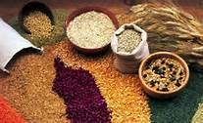
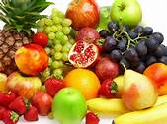
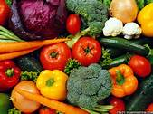
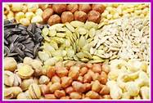
Fasting
Foods to include in your diet during the Daniel Fast
All vegetables. These can be fresh, frozen, dried, juiced or canned. Vegetables include but are not limited to artichokes, asparagus, beets, broccoli, Brussels sprouts, cabbage, carrots, cauliflower, celery, chili peppers, collard greens, corn, cucumbers, eggplant, garlic, ginger root, kale, leeks, lettuce, mushrooms, mustard greens, okra, onions, parsley, potatoes, radishes, rutabagas, scallions, spinach, sprouts, squashes, sweet potatoes, tomatoes, turnips, watercress, yams, zucchini, veggie burgers are an option if you are not allergic to soy.
All whole grains, including but not limited to whole wheat, brown rice, millet, quinoa, oats, barley, grits, whole wheat pasta, whole wheat tortillas, rice cakes and popcorn.
All nuts and seeds, including but not limited to sunflower seeds, cashews, peanuts, sesame. Also nut butters including peanut butter.
All legumes. These can be canned or dried. Legumes include but are not limited to dried beans, pinto beans, split peas, lentils, black eyed peas, kidney beans, black beans, cannellini beans, white beans.
All quality oils including but not limited to olive, canola, grape seed, peanut, and sesame.
Beverages: spring water, distilled water or other pure waters.
Other: tofu, soy products, vinegar, seasonings, salt, herbs and spices.
All fruits. These can be fresh, frozen, dried, juiced or canned. Fruits include but are not limited to apples, apricots, bananas, blackberries, blueberries, boysenberries, cantaloupe, cherries, cranberries, figs, grapefruit, grapes, guava, honeydew melon, kiwi, lemons, limes, mangoes, nectarines, oranges, papayas, peaches, pears, pineapples, plums, prunes, raisins, raspberries, strawberries, tangelos, tangerines, watermelon

Slide 7
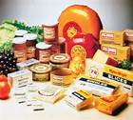
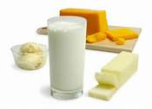
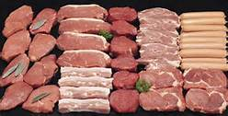
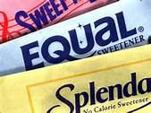
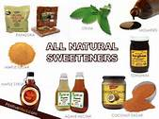
Fasting
Foods to avoid on the Daniel Fast
All meat and animal products including but not limited to beef, lamb, pork, poultry, and fish.
All dairy products including but not limited to milk, cheese, cream, butter, and eggs
All sweeteners including but not limited to sugar, raw sugar, honey, syrups, molasses, and cane juice.

Slide 8
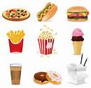
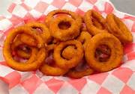
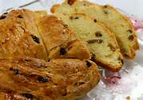
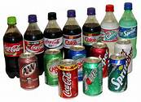
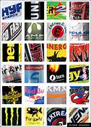
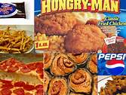
Fasting
Foods to avoid on the Daniel Fast
All leavened bread including Ezekiel Bread (it contains yeast and honey) and baked goods.
All refined and processed foods products including but not limited to artificial flavorings, food additives, chemicals, white rice, white flour, and foods that contain artificial preservatives.
All solid fats including shortening, margarine, lard and foods high in fat.
Beverages including but not limited to coffee, tea, herbal teas, carbonated beverages, energy drinks, and alcohol.
All deep fried foods including but not limited to potato chips, French fries, corn chips.

Slide 9
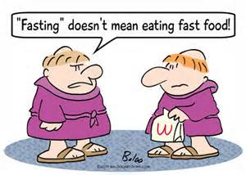
Fasting
Another way to fast is one meal a day fast
You simply limit your food intake to one meal a day! Of course sodas and processed foods should be avoided during your fast. If your fast doesn't mean much to you it won’t mean much to God either!

